Slide 1
Where is the Incentive? Rethinking Approaches to Security in Networks.
Karl Olson
University of Colorado – Boulder
PhD Dissertation Defense
February 29th - 2024

Slide 2
Agenda
Dissertation Overview
Background
Is there an incentive for security?
Dissertation Efforts
How have manufacturers been incentivized for security in the past?
Do lessons from the past serve as incentives for better security at present?
How can we better incentivize security adoption in the future?
Conclusion/Recommendations
Notes:
Here is the agenda I will cover. I will start with a little background on network security, with a focus on home networks to begin
I will then provide a short review of prior work, highlighting previous directions and efforts to incentivize security along with the challenges of realizing many of these visions
I will then present my research plan which I lay out as a four step investigation and solution effort focused on the four questions you see here. For the first half of my effort I focus on home networks and identifying challenges in this space before shifting focus to the broader internet in the second half.
I conclude with my key takeaways and proposed directions for research.

Slide 3
Background
Background:
Is there an incentive for security?

Slide 4
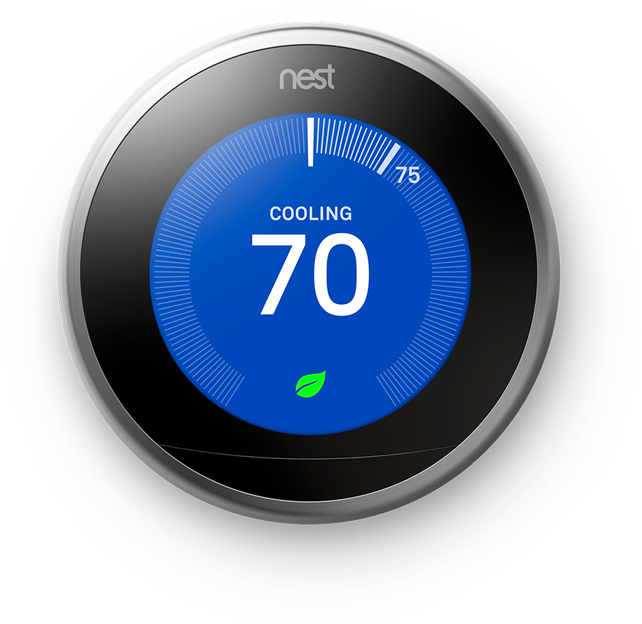

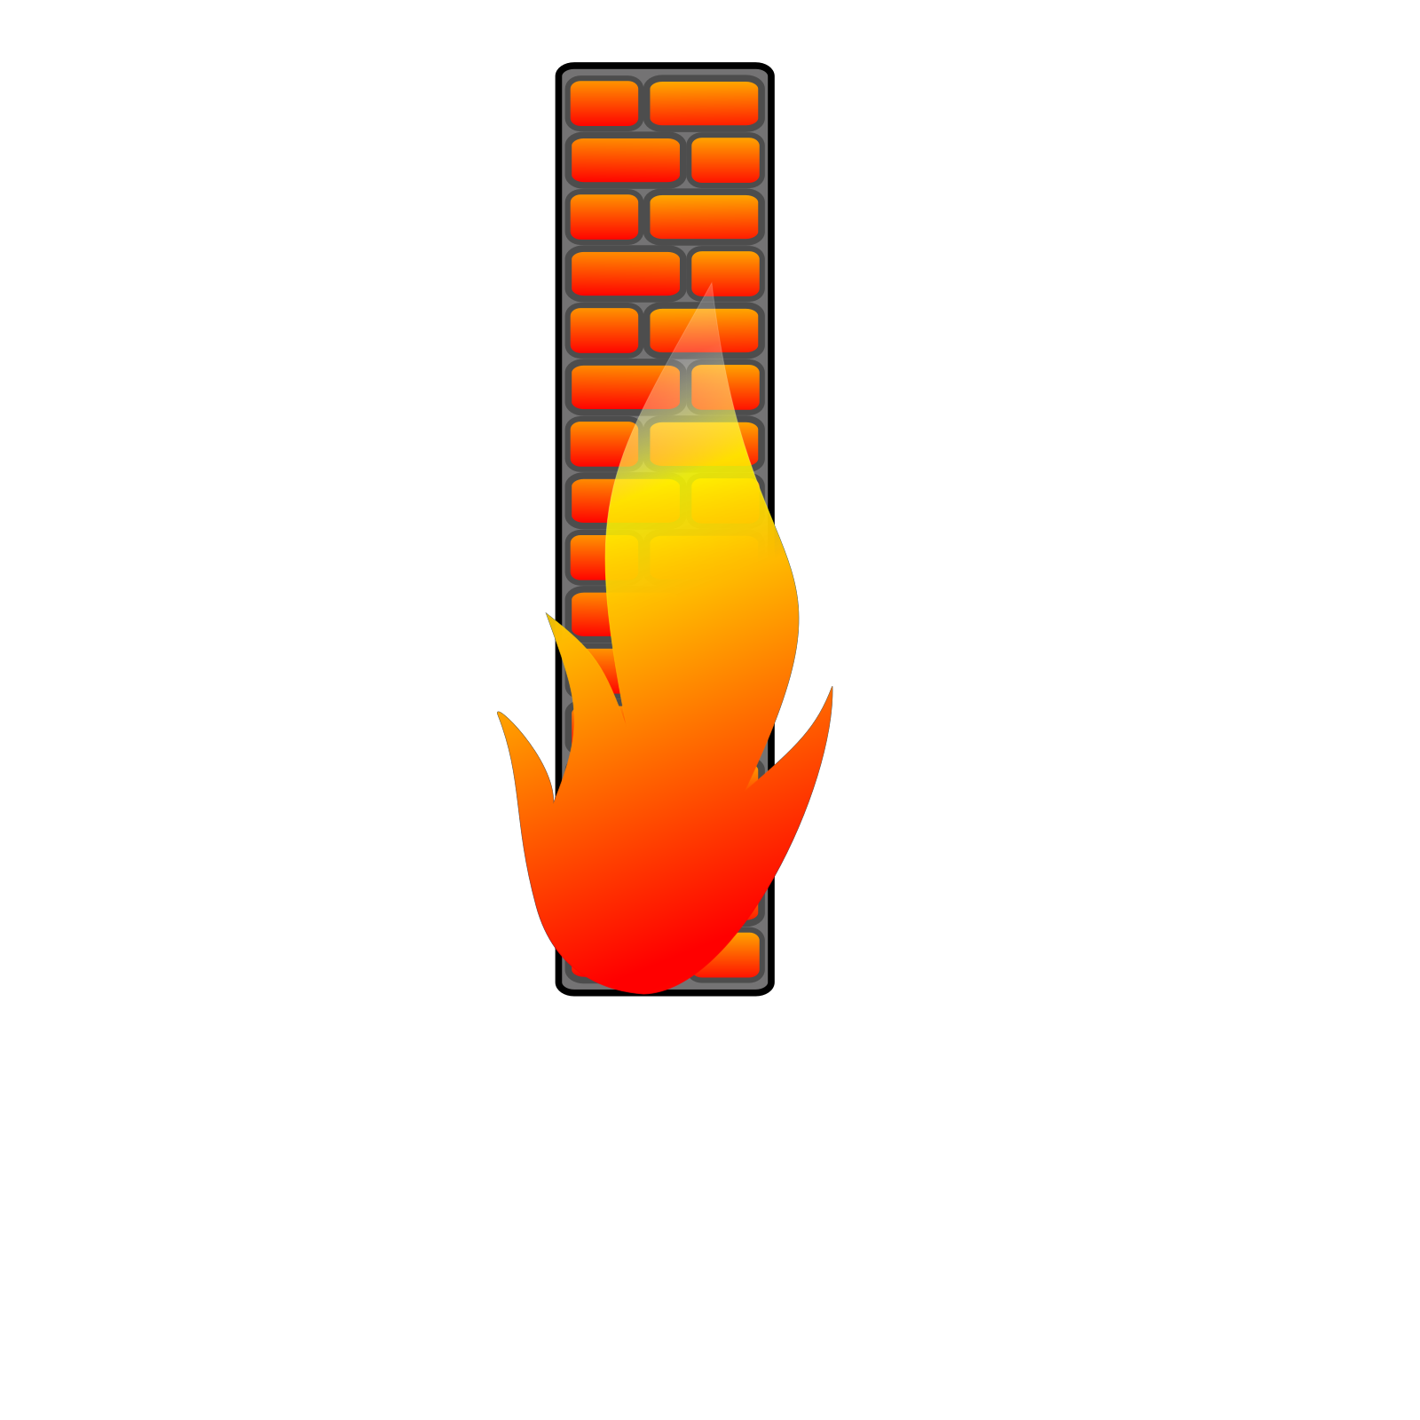
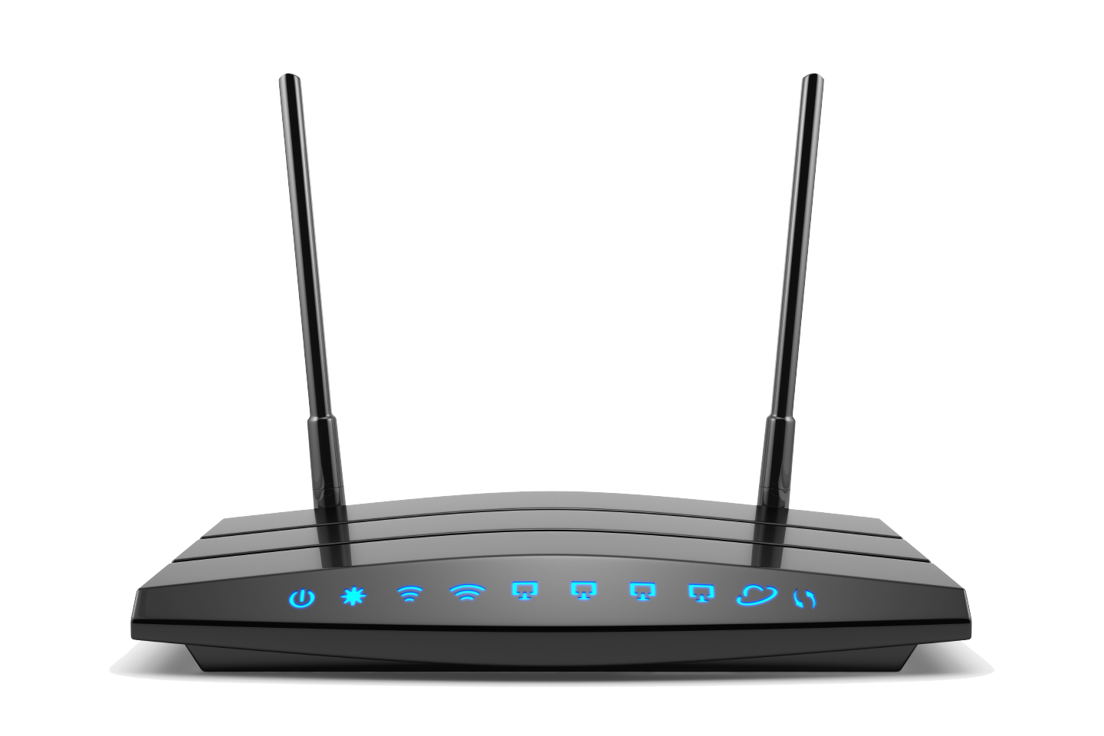




Background – SOHO Networks
Home Network
Perimeter Defense
Broad Zone of Trust Internal to Gateway
Limited Controls
Outbound traffic broadly permitted
Cable Modem
Internet
Network Provider
Home Router
Global IP: 145.88.x.x
Private IP Space: 192.168.x.x
Primary security control is NAT & default-deny security posture provided by gateway
Can implement stronger controls if desired (requires some level of technical understanding)
Address scarcity primary incentive to drive this design.
Notes:
We start with a simple model of home networking. Here consumer devices commonly link to a home router which links to a cable modem, usually provided by the ISP which then provides access to the broader internet.
The home router commonly serves as both a networking and security device, providing a defined security boundary separating the “trusted” network within the home from the broader “untrusted” internet.
Within this trusted boundary is a broad zone of trust where consumer devices are commonly able to freely communicate with the gateway and each other. Outbound traffic to the internet from these devices are broadly permitted.
The primary security mechanism in place comes from the address translation, which provides a default-deny security posture for external inbound connections that do not have an active outbound connection.
Users can implement stronger controls beyond what this default deny posture provides through NAT, either by implementing stronger firewall controls or filtering device access.

Slide 5
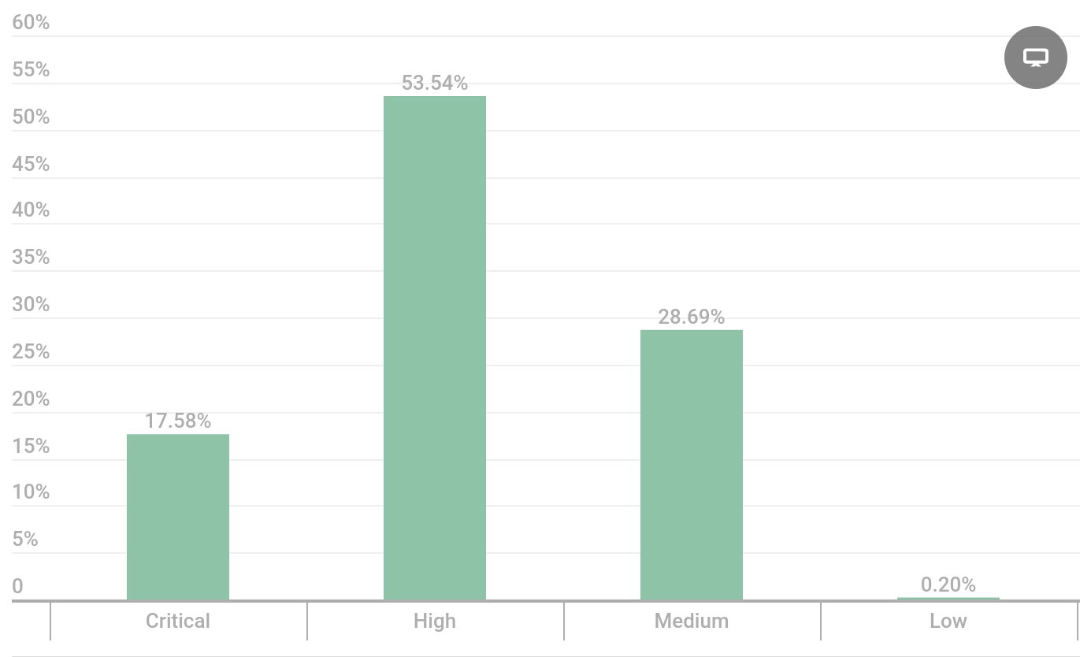
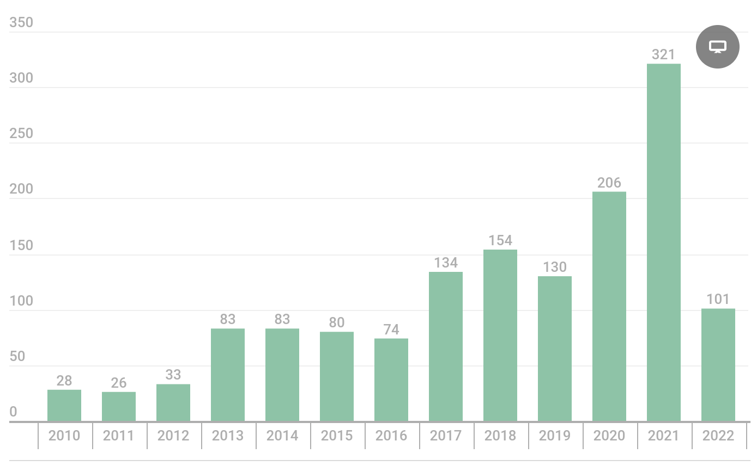
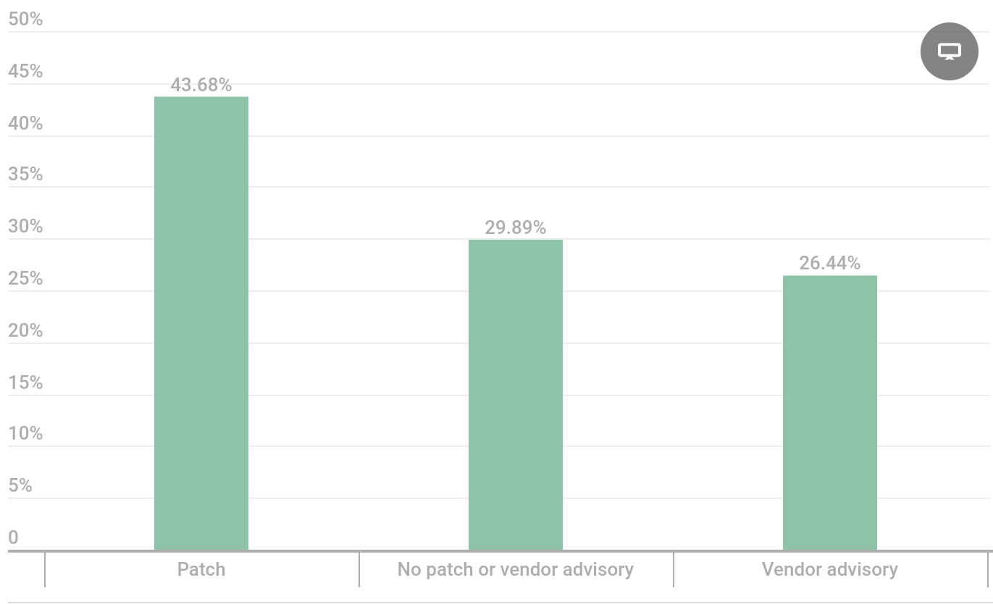
Background – SOHO Networks
1. Security has never been great
2. But problems are growing
3. Not small concerns
4. Less than half are ever addressed
https://securelist.com/router-security-2021/106711/
Notes:
What has this security model provided us? For one, security has never been great with home gateways. However, the amount of known problems and exposures has steadily been increasing.
These are not small concerns either, with over 70% of known vulnerabilities in gateways having either a high or critical rating.
But more concerning is that over half of these exposures never receive a patch. Often times a vendor will just simply announce there is an issue and provide recommended mitigation controls, which can include turning off common features of the device, or discontinuing use altogether.
And all of this assumes that the consumer is actively aware of these issues and involved in making clear security decisions, either through updating their patching, understanding that security advisory’s for products exist and they should make a decision based on their notes, or discontinue use altogether.

Slide 6
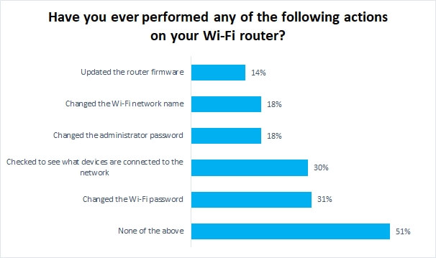
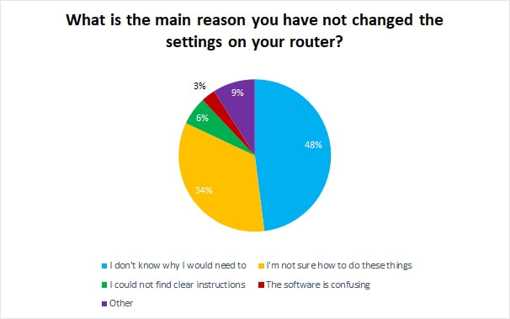
Background – SOHO Networks
Consumer’s rarely participate in their own security.
No clear incentive for this to change.
https://www.broadbandgenie.co.uk/blog/20180409-wifi-router-security-survey
Notes:
However, as we can see, consumers who operate these devices are no better, and rarely participate in their own security.
Of particular concern is the fact that from a survey of UK users by their comcast/Verizon equivalent provider broadbandgenie, more than half of users never touch their gateway or change a single default configuration.
If you look at the reasons why they have not done anything for their security, an overwhelming number show that they had no idea that they were supposed to do anything followed by a large percentage of people that claim they don’t know how.
This brings up an interesting question: what role should consumers have here in defining security of their networks? And should they really have any role at all?

Slide 7
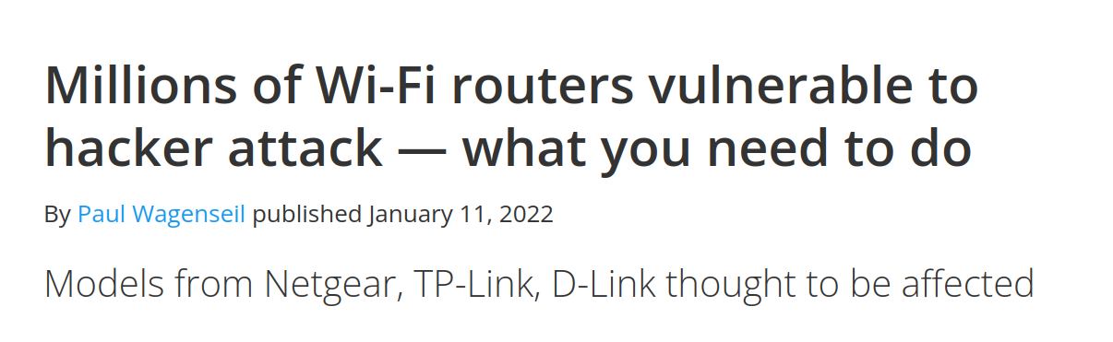
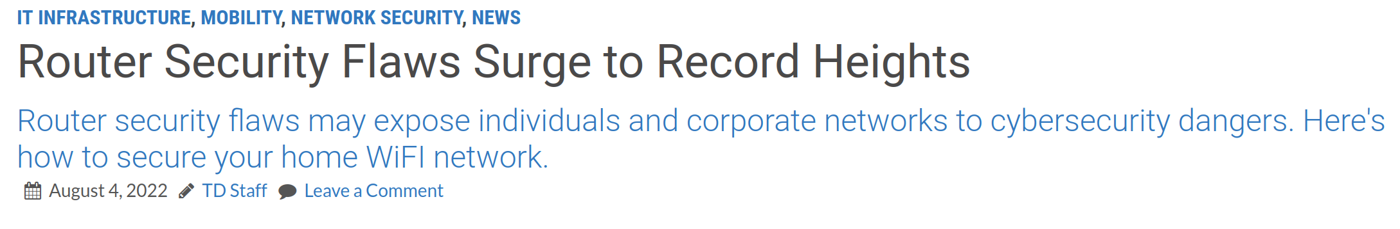
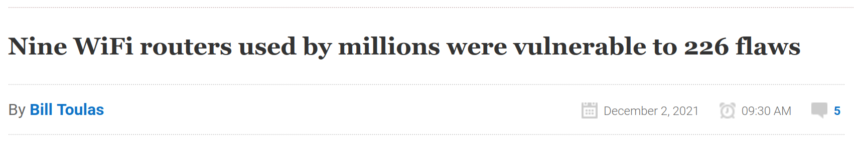
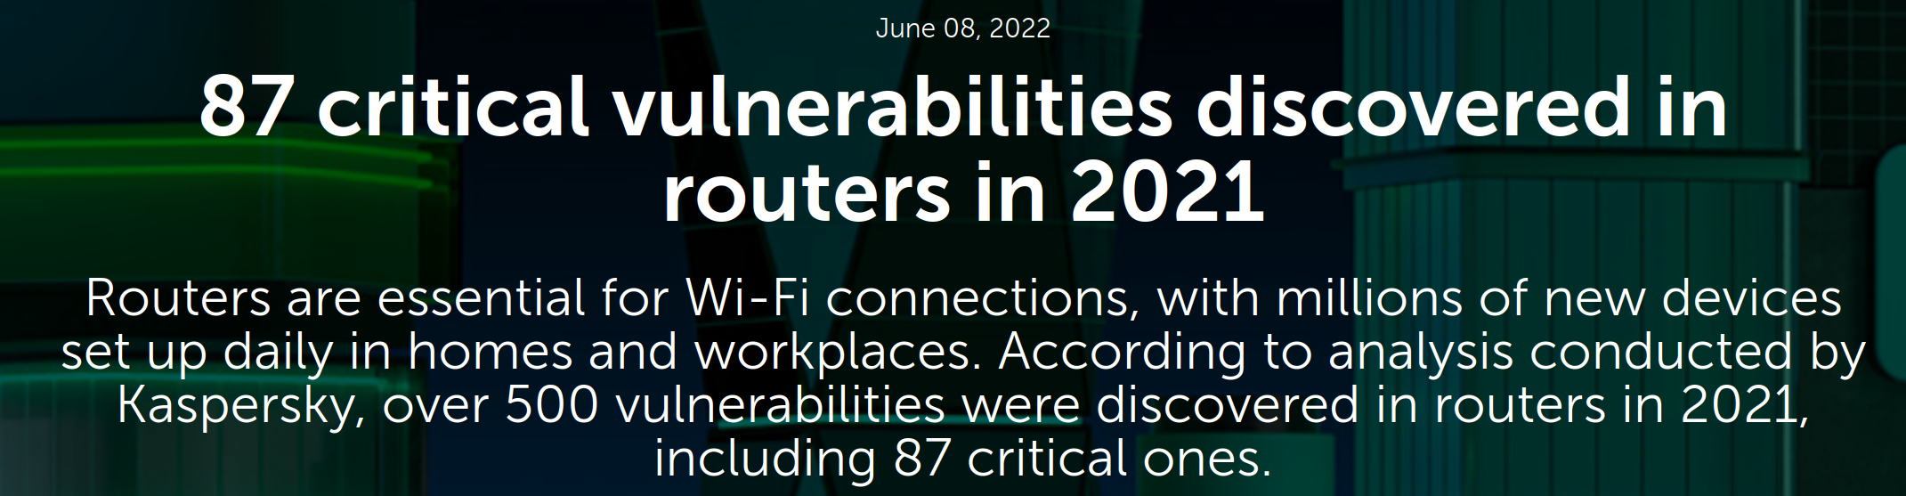
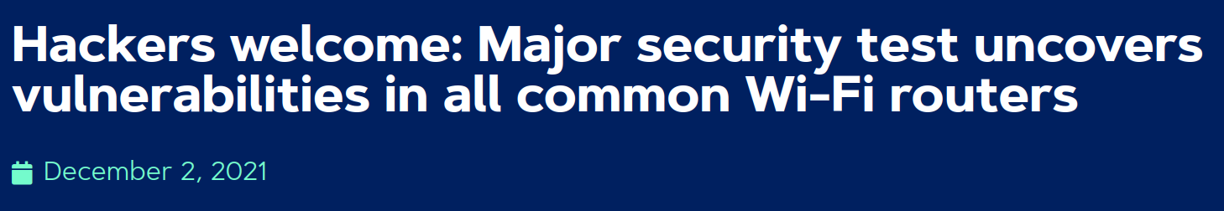
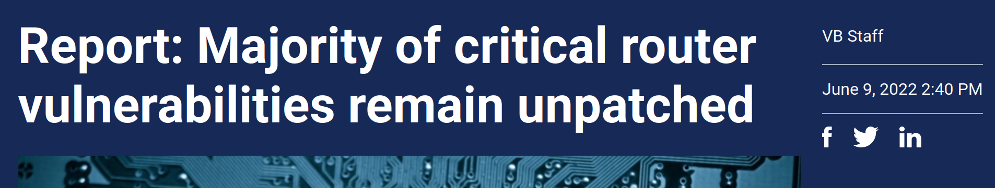
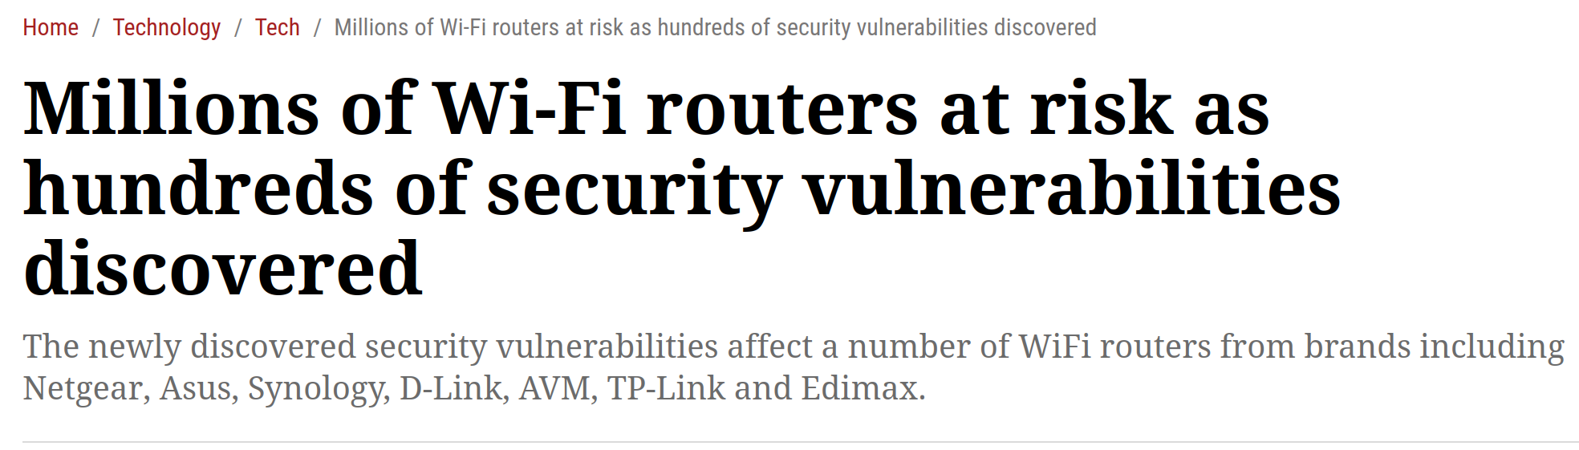
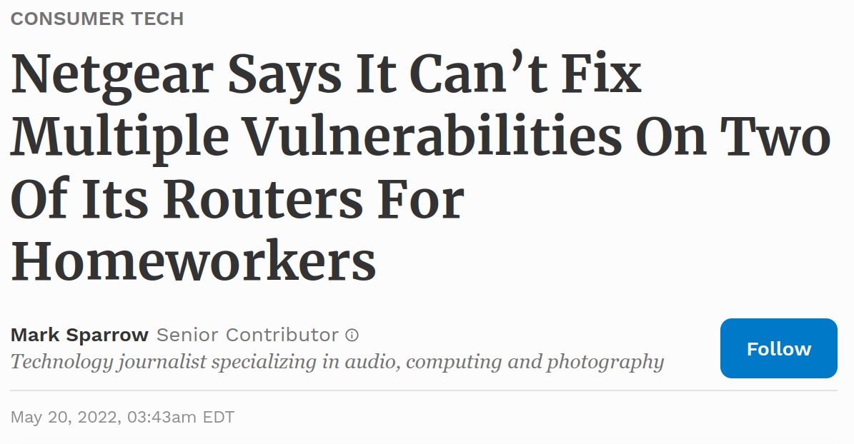
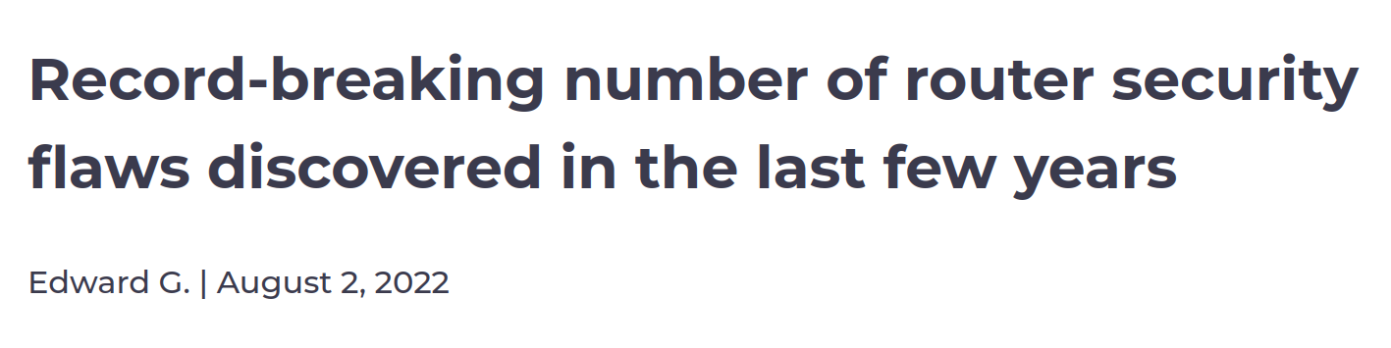
Background – SOHO Networks
This security model is not working.
Notes:
And so what have we gotten from this security model? Not a whole lot in terms of actual security.
Of note here: these news headlines all occurred within an 8 month period between December 2021 – August 2022 and these were just a sampling of news stories occurring during this period.

Slide 8
Background – SOHO Networks
Where is the incentive for security?
Home Networks:
1. Incentivizes early adopters (first to market)
2. Development cycles prioritize new release (shiny car)
3. Ease of use (abstracting security away from user)
4. Unclear role's and responsibility for security (user vs. Manufacturer)
5. No market incentive to maintain/update (no cost impact for non-compliance)
Internet Backbone (BGP):
Notes:
And so we ask the big question here, where is the incentive for security?
If we look at home networks in particular, we see an environment that is largely driven by market incentivization where competitors in the home gateway market compete to have their products stand out.
So things like first to market incentives for new features help products stand out. Often times these features are not fully developed or come with prototype code, rely on incomplete standards, etc.
If we look at the development cycles, manufacturers place their focus in building future sales, i.e. the next release. So supporting systems that already have been sold are likely to not be a priority. We tend to see this in the long delay between patches found in most of these system where it can take upwards of a year or more for a patch to come out.
From a consumer perspective, complexity often adds additional costs for the manufacturer, often in terms of product support and troubleshooting, so providing broadly simple systems that prevent user mistakes or need to do much are desirable. However this commonly translates in broad deployment of options that are often unneeded, such as UPNP, or insecure baselines such as disabled firewalls as a starting point. The problem with this approach is that manufacturers place responsibility on a user to harden their systems and users typically don’t do anything.
So that leaves the question who is really responsible for security? Is it the users? Is it the manufacturers? Is it a 3rd party standards agency?
What we are left with is an insecure environment, where there is not only ambiguity for responsibility, but no clear incentive to do anything about it.

Slide 9

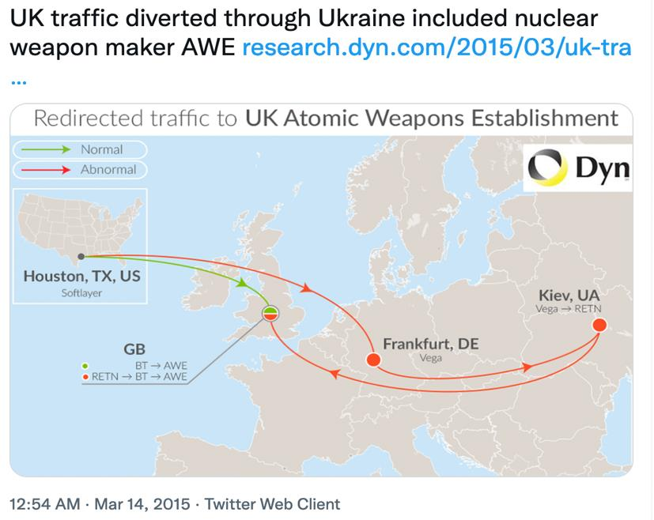


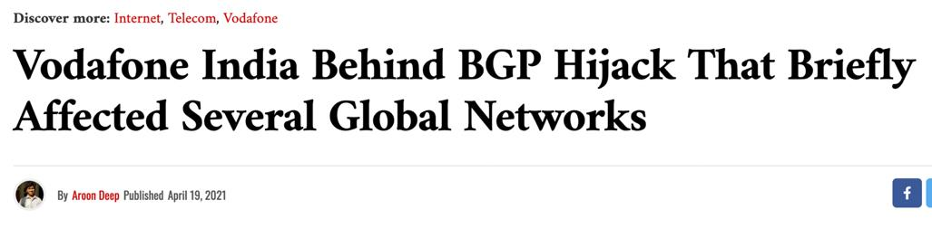
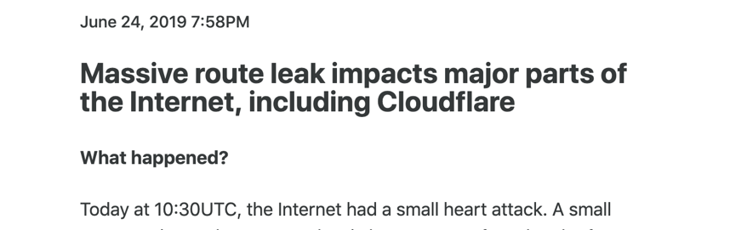

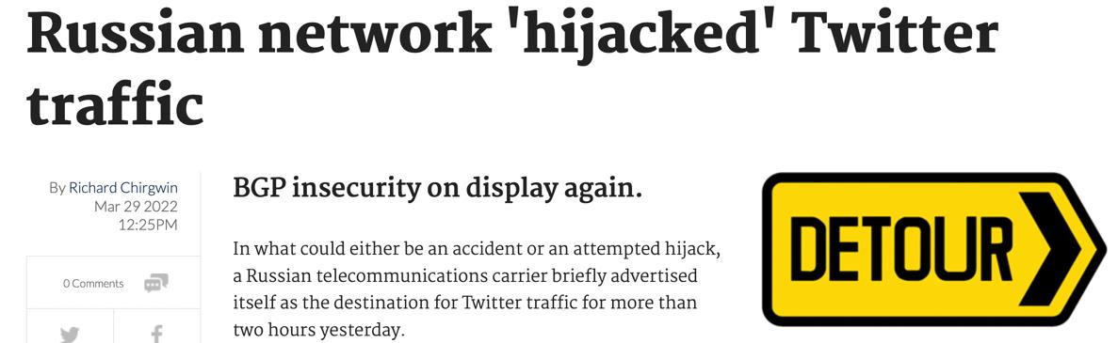

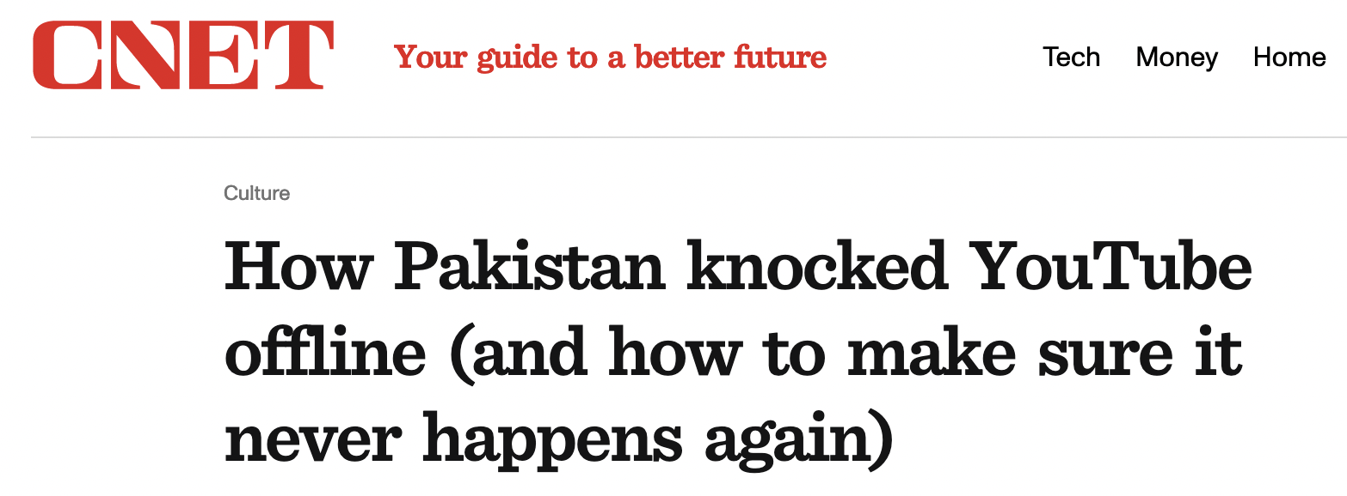


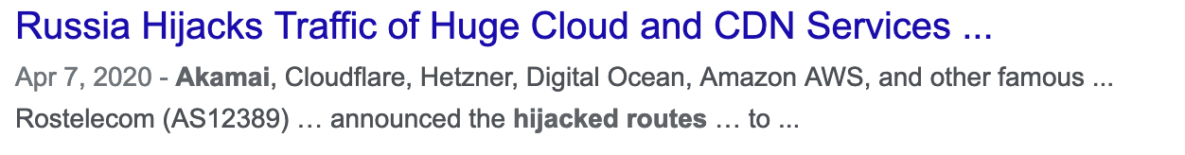
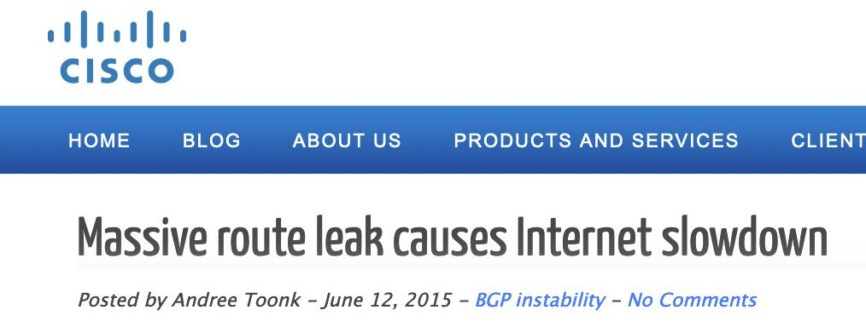

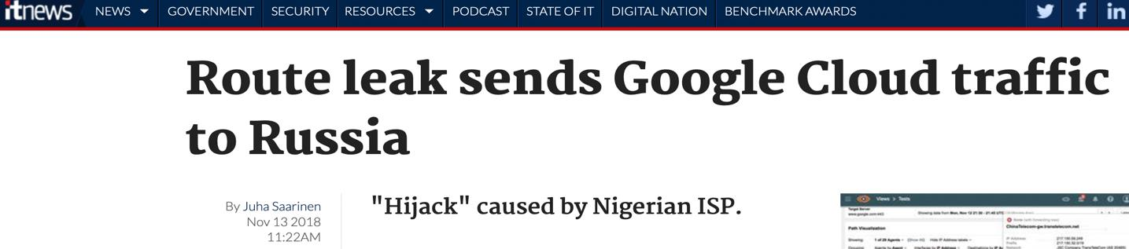

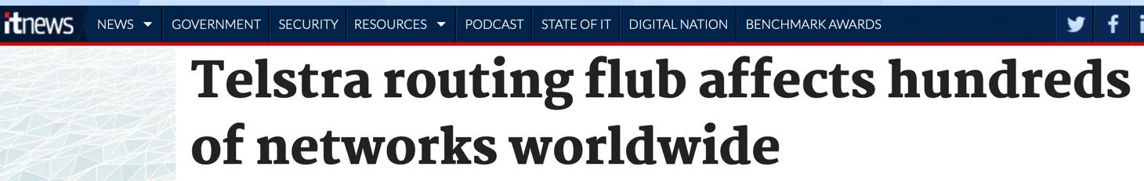

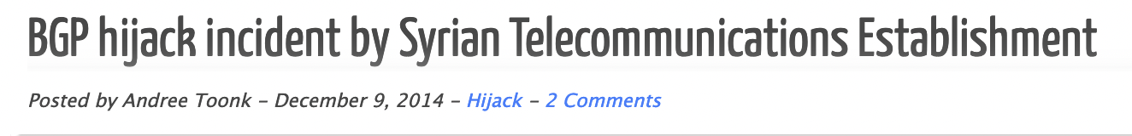
Background – Internet Security
The protocols that run our networks are no better.
But we have security solutions here…so what is the problem?
Notes:
If we look at the protocols that run our backbone, we see much of the same challenges as with home routers.
Repeat security exposures, same flaws, little improvement over time despite decades of knowing about the issues.

Slide 10
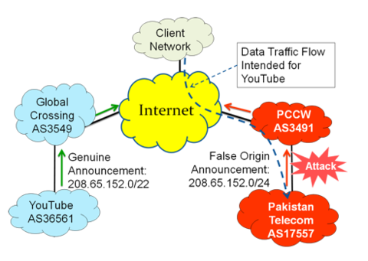
Background – Internet Security
BGP Hijacking:
2008 – Pakistan blocks Youtube
2017 – Russia hijacks prefixes belonging to international banks
2018 – China Telcom originates Google addresses bringing Google services offline.
2019 – European mobile traffic routed through China
2022 – Attackers hijack BGP traffic for South Korean crypto platform, steal $2 mil of cryptocurrency
Notes:
One of the main issues with BGP is prefix hijacking which occurs when an ASN owner advertises a network prefix belonging to someone else.
When this occurs, a network announcement is propagated throughout the network with competing route information. Upstream routers will see this information and make a selection, based on prefix length or shortest path, resulting in either all or some portion of the network being routed to the wrong host.
So here on the right we have the 2008 youtube outage where Pakistan tried to prevent access in youtube in their nation. What they were trying to do was black hole or prevent routing towards the youtube network. What they ended up doing however was routing the internets traffic for youtube to their domain.

Slide 11

Background – Internet Security
Prefix Hijacking
Sub-Prefix Hijacking
11.0.0.0/24
11.0.0.0/24
11.0.0.0/24
11.0.0.128/25
Notes:
So to explain this in a little more detail, with prefix hijacking you have a network owner who has announced their network and all traffic routes to them across the internet for this prefix.
With a prefix hijack, some other network advertises the same information. Based on this there are conflicting routes. BGP uses an algorithm to pick the best route, and in this case, the shortest path is chosen, resulting in a portion of the network routing to the wrong location.
Sub prefix hijacking is slightly different in that an attacker advertises a more specific route. When this happens, router will always choose the more specific route, resulting in all routers routing traffic toward the attacker.

Slide 12

Background – Internet Security
Solution: Route Origin Validation (RPKI)
Cloudflare “Too expensive to adopt as proposed, created a modified solution”
Value occurs at broad adoption, no incentive for early adopters.
Still susceptible to path manipulation
Represents significant adoption costs and complexity risk for administrators.
Delay in record freshness, ~5 minutes advertisement, ~30 minutes withdrawl.
Let me check!
Local RPKI DB
S{11.0.0.0/24}
11.0.0.0/24
RPKI – Decade of deployment ~40% adoption
Notes:
So what solutions exist to fix these problems?
First we have RPKI, which stands for Resource Public Key Infrastructure. Here a route owner signs their route information with their private key. This information is then published to an RPKI database, which can then be used by other ASNs to validate route announcements off of.
When someone else trys to publish the same route, a router is then able to reference the database of information and either accept or deny the route announcement based on the validation result.
Because of heavy processing requirements for PKI, each ASN deploys a local RPKI validation server, which validates the route records from a master database, allowing local ASN routers to quickly and easily query the local DB for route information.
This architecture presents a few issues.
First is the cost. Implementing RPKI servers within each ASN can be a costly endeavor. Cloudflare even announced that following this model would be cost prohibitive.
Second, the value here occurs when a large percentage of ASNs have adopted the solution. If you are the first one to implement, there is little value here for you….however you are incurring large costs and additional complexity->both discincentives for deployment.
So what has this design resulted in? Well after a decade, we are hovering around a 40% adoption rate. Not exactly great.
Even if you implement RPKI, it does not prevent all types of attacks.

Slide 13
Background – Internet Security
AS-Path Prepend
192.0.2.0/24
192.0.2.0/24 AS_Path 2,1
AS5
AS3
192.0.2.0/24 AS_Path 4,3,2,1
192.0.2.0/24 AS_Path 4,666,1
AS1
AS4
192.0.2.0/24 AS_Path 3,2,1
AS2
192.0.2.0/24 AS_Path 666,1
192.0.2.0/24 AS_Path 1
192.0.2.0/24 AS_Path 1
AS666
Notes:
So the second major type of attack is the AS_Path Prepending.
Here, when a route is announced, it propogates along a path. Each router appends their ASN number to the path along the route, allowing for everyone to view the path a packet will traverse from their location.
With AS Path prepending, an attacker can say they have a path to someone else. That information will get propagated. Other routers will see this as a shorter path and end up preferring the route over the true path.

Slide 14
Background – Internet Security
Solution: Path Validation (BGPsec)
AS60
AS70
AS80
“Hold on guys, I need to verify all these signatures”
I’m AS50, sending to AS 60
I’m AS60, sending to AS 70
I’m AS70, sending to AS 80
S{
}
S{
}
S{
}
Places cost on verifier.
All or nothing. 1 non-participant, whole system reverts.
Requires broad participation for value.
I’m AS50, sending to AS 60
I’m AS60, sending to AS 70
S{
}
S{
}
I’m AS50, sending to AS 60
BGPsec – Decade of deployment ~0% adoption
S{
}
Notes:
So to fix this solution, BGPsec is the leading approach.
Here each router along the path signs their announcement with their information and the router they are sending the info to. When a router wants to validate the path, they must then validate the series of signatures to ensure that an unbroken chain has occurred and the path is true.
The problem here is that this places a heavy calculation cost on the routers to perform this verification and many are likely unable to perform the required level of computation constantly.
The second issue is that this design requires an unbroken chain of signatures in the path. As soon as one non-participant is reached, the whole system reverts to normal operation without the signing.
So here we have found almost no adoption.

Slide 15
Background – Internet Security
Current challenges with BGP routing security
1. Decentralized operation – hard to get broad buy-in easily. No flag day.
2. Limited partial deployment value. Eg. BGPsec = all or nothing or RPKI value based on broad deployment.
3. Added complexity and cost to operator
4. BGP works as-is– if everyone is an honest broker.
End result: Little incentive to change. Unclear value for partial deployments. Clear up-front costs to implement.
Notes:
So where does this leave us currently?
1st the decentralized operation of BGP makes it hard to get broad buy-in easily. And because of the necessity of the internet, we are unlikely to ever get a flag day to broadly deploy a new solution.
Second, all of these solutions find their value after broad deployment. There is limited value here in being the first to adopt or participate in a partial deployment scenario.
Third, these solutions all add additional costs to administrators, serving as further discincentives.
Plus at the end of the day, BGP works, as long as everyone is an honest broker. Its not perfect, but it isn’t completely broke either.
So the end result, there is little incentive to change or adopt these security efforts.

Slide 16
Background – Internet Security
Where is the incentive for security?
Home Routers:
1. Incentivizes early adopters (first to market)
2. Development cycles prioritize new release (shiny car)
3. Ease of use (abstracting security away from user)
4. Unclear role's and responsibility for security
5. No market incentive to maintain/update
Internet Backbone (BGP):
1. No incentives for early adopters (Partial Deployment)
2. Solutions add complexity and overhead
3. Distributed model challenges centralized solution
4. Unclear role's and responsibility for security
5. No market incentive to change
#1 The need for security is not a strong incentive for adoption on its own.
#2 Costs to implement cannot outweigh value gained.
Notes:
So looking at BGP, we again see an environment where the incentives for security and broadly mismatched with current security solutions, and in many cases actually work against their adoption.

Slide 17
Prior Work
Prior Work

Slide 18
Prior Work – Incentivizing Security
Incentivizing Cybersecurity Compliance in the New Digital Age: Prevalence of Security Breaches Should Prompt Action by Congress and the Supreme Court. Modesti, C. (2018).
Call for congress to lead regulatory change and specify baseline security requirements.
Rosson, J., Rice, M., Lopez, J., & Fass, D. (2019). Incentivizing cyber security investment in the power sector using an extended cyber insurance framework.
Insurance can be a strong driver for security requirements.
How to dynamically incentivize sufficient level of IoT security. Su, J., Et. Al. (2020).
Smart contract-based compliance monitoring to determine insurance premiums.
An informative security and privacy “nutrition” label for internet of things devices. Emami-Naeini, P., Et. Al. (2021).
Consumer device labelling standards for security.
Takeaway: Proposals and directions to incentivize security exist, but mostly remain an academic exercise, e.g. too complicated, initial costs, low industry acceptance.
No action has been taken to broadly address security incentivization to date.
Notes:
Looking at the prior work for incentivizing security there are a number of papers over the last five years. Here I capture probably the strongest ones that highlight the 4 common arguments for change.
First we have the regulatory approach which calls for congress to enact change. This is probably the strongest approach to see a true solution here, which I will discuss more on later. The challenge here is that many of these papers call for action broadly, but fail to account for polarization in government or how to achieve their vision specifically. For example, broadly calling out consumer home routers can be taken as encroachment on personal rights in which the government has no place being. So this often leads to inaction.
Another direction is the compliance approach utilizing insurance directives. Here conditions of insurance require certain security controls to be met as conditions for the insurance. However this remains a quite new direction with a lot of uncertainty making costs high. While this may align well with commercial use, its unclear if there would be a market for general consumers.
A third direction is introducing technical solutions. However, these often introduce significant complexity while growing the security footprint of systems. It is also unclear whether or not consumers are interested in additional technical approaches.
A fourth method is focused on consumer awareness for security where an increased awareness will require manufacturers to compete for market utilizing security as a selling point. A number of papers have presented device labelling standards that call out things like product security update support length, security test certifications, or patching response times. The goal here is that by forcing manufacturers to list their support, and by encouraging consumer awareness, this method can help drive better outcomes for security. However, there is no guiding agency here to force this and manufacturers have not taken it on themselves to do so at this time.
So broadly speaking, these directions have largely remained an academic exercise rather than actual solutions.

Slide 19
Dissertation
Thesis Statement:
Poor incentivization for network security has enabled a pervasive environment of insecurity. Proper incentivization can change this paradigm.
SOHO Networks
How have manufacturers been incentivized for security in the past?
Do lessons from the past serve as incentives for better security at present?
How can we better incentivize the adoption of security solutions or outcomes in the future?
“Doomed to Repeat with IPv6? Characterization of NAT-centric Security in SOHO Routers”
“NATting Else Matters: Evaluating of IPv6 Access Control Policies in Residential Networks”
Internet Backbone
“DnD-DB: Democratized Network Data Database for Tailored Routing and Security Campaigns”
Notes:
My thesis statement is that poor incentivization for network security has enabled a pervasive environment of insecurity, and more importantly, we can fix this through proper incentivization.
To answer this, I break my research into two areas: Home Networks and the broader internet itself. In the first half of my research I focus on understanding how security has been traditionally approached by gateway manufacturers to form a basis of understanding of how system security design has been shaped by factors such as standards, the market, and consumer involvement. For this I focus on the security model afforded by Network Address Translation and the protocols used to configure policies in the security boundary offered thru NAT.
Based on this the lessons found in the first effort, we then look to IPv6 in order to understand how manufacturers are applying security lessons built up over the last two decades in order to see if they are applying these lessons to new paradigms and if not, why?
I then shift focus to the Internet backbone, and look at the challenges associated with BGP and why this protocol that runs the internet continues to be a security challenge despite security solutions to address these challenges existing for more than a decade. What I argue for is that these solutions have presented unclear or poor incentives for adoption, hindering their acceptance by the community. To fix this, we need to better incentivize solutions, such that people will readily adopt them.
I then finish with my proposal for how to demonstrate an incentivized design for security.

Slide 20
Dissertation Effort #1
How have manufacturers been incentivized for security in the past?
SOHO Networks
How have manufacturers been incentivized for security in the past?
Do lessons from the past serve as incentives for better security at present?
How can we better incentivize the adoption of security solutions or outcomes?
“Doomed to Repeat with IPv6? Characterization of NAT-centric Security in SOHO Routers”
Internet Backbone
Notes:
So now I will cover the first part of my effort focused on understanding how manufacturers have evolved our approaches to security in consumer gateways by focusing on understanding the security model afforded by NAT.

Slide 21
Dissertation Effort #1
How have manufacturers been incentivized for security in the past?
How have manufacturers been incentivized for security in the past?
NAT Overview
SRC: 192.168.1.5
DST: 88.121.90.10
SRC: 174.88.220.7
DST: 88.121.90.10
192.168.1.5
174.88.220.7
88.121.90.10
“If I get anything back from 88.121.90.10 I should send to 192.168.1.5”
Notes:
Just a brief Intro on how NAT works.
Here on the left, a user is seeking to make a connection out to the internet traversing across their home gateway. This gateway has provided them with a private IP address, meaning it is reserved for local use and is not routable on the global internet.
So when an outbound packet is sent, this private IP belonging to the host needs to be converted to a new IP that is globally routable. This occurs in the gateway through network address translation. Here the gateway first creates a forwarding record in the translation table relating the request by the user to the target destination and then updates the packet SRC header to that of the external interface of the gateway, which contains the globally routable address, allowing the packet to then be routed to its destination.
On return, the packet is received by the gateway, a lookup occurs to relate the source IP to the local host and the packet is finally forwarded to the original sender.
If there is no relation in the table to be found, a packet is dropped. In this way, NAT offers a clear security boundary that creates a default-deny security posture for unsolicited traffic.

Slide 22
Dissertation Effort #1
How have manufacturers been incentivized for security in the past?
Understanding the role of NAT and Hole-punching protocols in SoHo Security
NAT provides an "Appropriate" level of security for consumers. Firewalls likely too complicated.​ - Network security using NAT and NAPT (M. Smith 2002)
1. Provides a default-deny baseline security policy
2. Masks internal network from public
3. Serves as a simple and automatic firewall for consumers (little involvement)
Win-Win!
1. Manufacturers could minimize security development/integration of more complex systems for security management.
2. Consumers got a simplistic default security mechanism that required little to no involvement.
3. Security was a perimeter solution to keep bad guys out!
Notes:
So what has this security model provided us?
First, an early paper from 2002 kinda set the tone, identifying NAT as providing an appropriate level of security. Here the authors also noted that stronger mechanisms like firewalls were likely too complicated for consumers.
From the consumer perspective, NAT offered a clear baseline security policy that provided a default-deny firewall “equivalent” capability for unsolicited traffic from the internet.
Second, it provided some level of obscurity, masking devices from a users internal network from the broader internet. Even though this was a debatable benefit.
Third, it was simple for consumers. There was nothing they had to do to configure and receive these security benefits.
From a manufacturer perspective, they could minimize development and integration of more complex systems for security.
2. It would minimize consumer involvement, minimizing challenges on configuration or setup.
3. It defined the network gateway as a perimeter security solution, which allowed development of network devices for the internal network to forgo their own security implementations.
And broadly speaking, this was viewed as a win-win for both groups.

Slide 23
Dissertation Effort #1
How have manufacturers been incentivized for security in the past?
NAT is not without issue.
Broke end-to-end design of internet and systems that relied on a fully reachable architecture (VOIP, Peer-to-peer)
2. Fixing required placing "holes" in defensive boundary.
3. Consumer's rarely involved with configuration
Solution: Automate hole-punching too!
Endstate:
1. Simplistic security system where user security involvement has been abstracted away.
2. Consumer placing full trust in a system to behave securely and in their best interest.
3. Added device complexity
Notes:
However, NAT wasn’t without issue.
First, it broke the end-to-end design of the internet and the systems that relied on a fully reachable architecture such as voip or peer-to-peer solutions. Specifically, these devices called into a network as an initial solicitation, which was precisely the type of traffic NAT is great at blocking.
To fix this break in design, gateways would have to place holes in the defensive perimeter afforded by NAT in order to allow this inbound communication from these protocols.
However, placing holes meant consumers had to get involved. Meaning they had to understand what the challenge was, and then precisely implement the configuration necessary to achieve the result. Likely an untenable approach.
So the solution was to create protocols which would help automate hole-punching in the nat perimeter.
What we ultimately got from this approach was an overly simple security system where consumer involvement had been abstracted away from them.
Consumers believed that they had a device that operated securely and operated in their best interest.
And more importantly, we got a more complex system than the original security vision of NAT considered.

Slide 24
Dissertation Effort #1
How have manufacturers been incentivized for security in the past?
What have we got from this NAT-centric security model?
Notes:
So what has this NAT centric model provided us?
A whole lot of insecurity.
So the big question is why? What is wrong here?

Slide 25
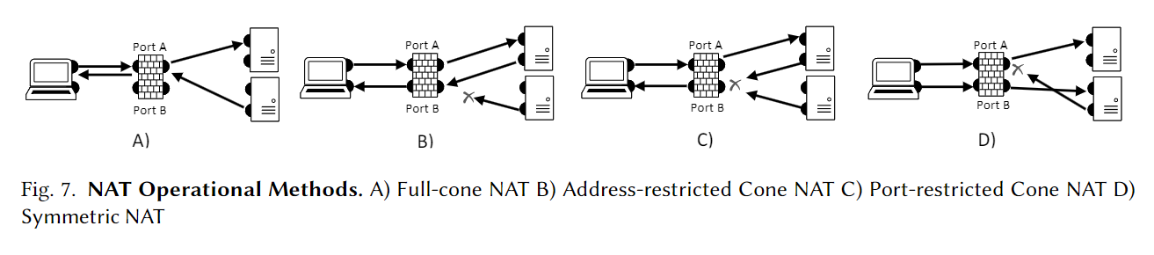
Dissertation Effort #1
How have manufacturers been incentivized for security in the past?
Unclear standards enabled environment of ambiguity
NAT never formalized until 10 years after significant adoption
Broad interpretation resulted in complex operating environment
Additional differences between manufacturers add more complexity, e.g. TCP SYN Timeouts, Port Sequencing, etc.
Addressing various NAT methods requires equally diverse hole-punching methods = added complexity and uncertainty
Notes:
Looking at NAT more closely what we need to understand how it has evolved.
First, NAT was proposed in 1994 as a solution to extend the available IP4 addresses by utilizing private IP space. Because the internet was rapidly growing, there was concern of address exhaustion. Because of this, NAT quickly caught on and was implemented broadly, especially by gateway manufacturers.
However, this initial RFC 1631 only described general concepts, not precise behavior. So manufacturers were left to decide how to implement, resulting in a wide range of NAT and ultimately device operation.
Showing some of these behaviors here, under A, an outbound request could establish an open port for return communication. However, there were no specific checks for device IP, allowing for anyone to send traffic to the port and then the host.
In B, other manufacturers implemented controls by IP, but allowed returning communications to use any port, regardless of which one was initially used.
In C, some would implement translation only by port, while in D, both address and port restrictions were in place.
Further, other areas, such as with port selection, could follow a random selection process, or a sequential selection, or even a first available process, adding complexity and uncertainty for trying to create hole-punching mechanisms that would work with these behaviors broadly.

Slide 26
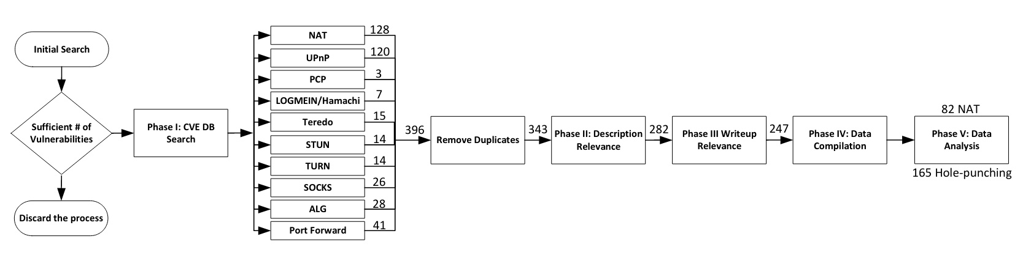
Dissertation Effort #1
How have manufacturers been incentivized for security in the past?
Investigation Methodology
Notes:
So to understand what all this uncertainty means from a security perspective, we conducted an investigation into the security exposures surrounding NAT and the many diverse hole-punching methods in order to understand how this ambiguity in operation has broadly defined the operational environment.
To do so we first conducted a search of the CVE database to determine that there was enough references that could be used to help shape our understanding. We then gathered all CVEs related to either NAT or one of the hole punching methods you see here. For this we looked at both the NVD database and MITRE database.
We removed duplicates, and then conducted a read-thru of each CVE in order to ensure relevance to our focus. If relevance could not be determined by the CVE description, we then dove into writeups. Finally we compiled the resulting data and provided analysis.
At the end of this we ended up with 82 NAT and 165 hole punching CVE’s

Slide 27
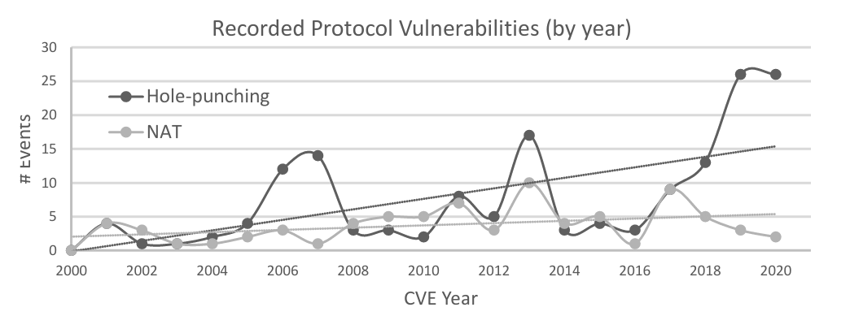
Dissertation Effort #1
How have manufacturers been incentivized for security in the past?
1. NAT integrated into linux-kernel via Netfilter package which 90% of home routers use. - single package maintenance vs. 1500 UPnP implementations (though 10 represent 90% of home gateway implementations - Excl. Versioning)
2. NAT implementation roughly 1000 LOC vs 45k for UPnP; roughly 15-50 bugs per 1000 LOC...
3. Lack of patching – roughly 25% of SoHo routers in 2020 still used UPnP 1.0 worldwide
4. Little incentive for manufacturers to update packages – testing costs, time, potential conflicts, etc.
Notes:
Mapping these results out, the first thing that stands out is that exposures in both NAT and hole-punching methods have increased over time, but more so in the hole-punching protocols.
First, we reason that this is first due to the scale of each protocol. For NAT, we commonly rely on a single linux kernel package which is used by 90% of home routers. This provides for a generally robust focus on a single package for maintenance compared to a wide array of packages used by supporting hole-punching protocols. If you l look at just UPnP, which is probably the most common hole-punching protocol in home gateways, there are about 10 different implementations used depending on which manufacturer you chose.
Second, NAT is a much smaller program, roughly 1000 lines of code vs the roughly 45k lines of code for UPnP. If we assume an average of 15-50 bugs per 1000 lines of code….you can expect a lot more exposure by hole-punching protocols compared to NAT.
Third, many gateways continue to utilize known vulnerable versions of packages despite updates being available prior to their release. Its unclear whether this is just oversight, or if there is another reason. But broadly speaking, manufacturers integrate 3rd party packages into their systems but often they do not manage these in their system updates.
Really, from a manufacturer perspective, there is little incentive for manufacturers to do anything about this, at least with released systems. Patching these systems with updated 3rd party packages may have 2nd or 3rd order effects on system operation which takes time to test and fix – actions which are costs to the business.

Slide 28
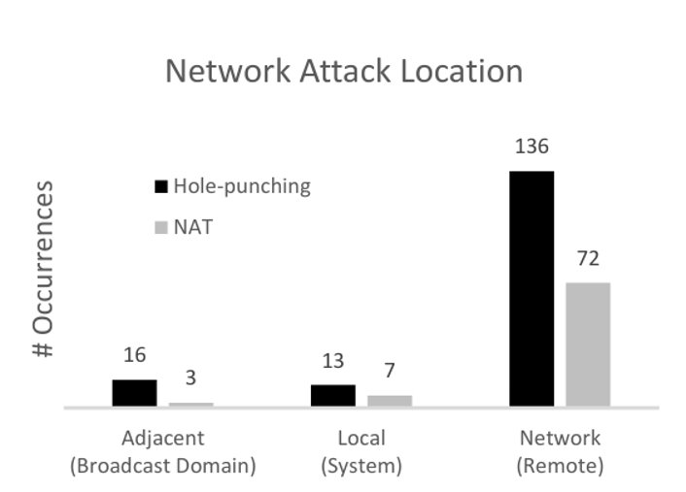
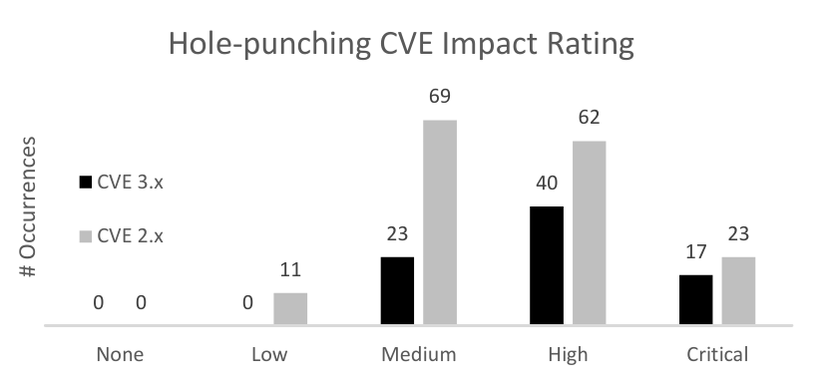
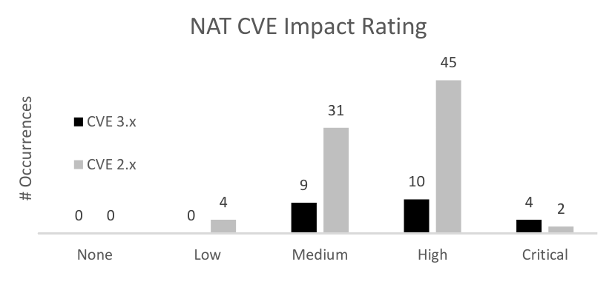
Dissertation Effort #1
How have manufacturers been incentivized for security in the past?
1. Most attacks remotely exploitable
2. There is significant exposure from these flaws
3. There is a little a consumer can do about these other than “wait for a patch”.
Notes:
Looking at these vulnerabilities a little closer, a concerning point is that the vast majority of exposures can be leveraged from a remote network.
Second, there is significant exposure from many of these flaws, reflecting a significant threat to a consumer for both NAT and hole-punching.
Third, there is little here that a consumer can do about any of these other than wait for a patch as the issues are not consumer level controls.

Slide 29
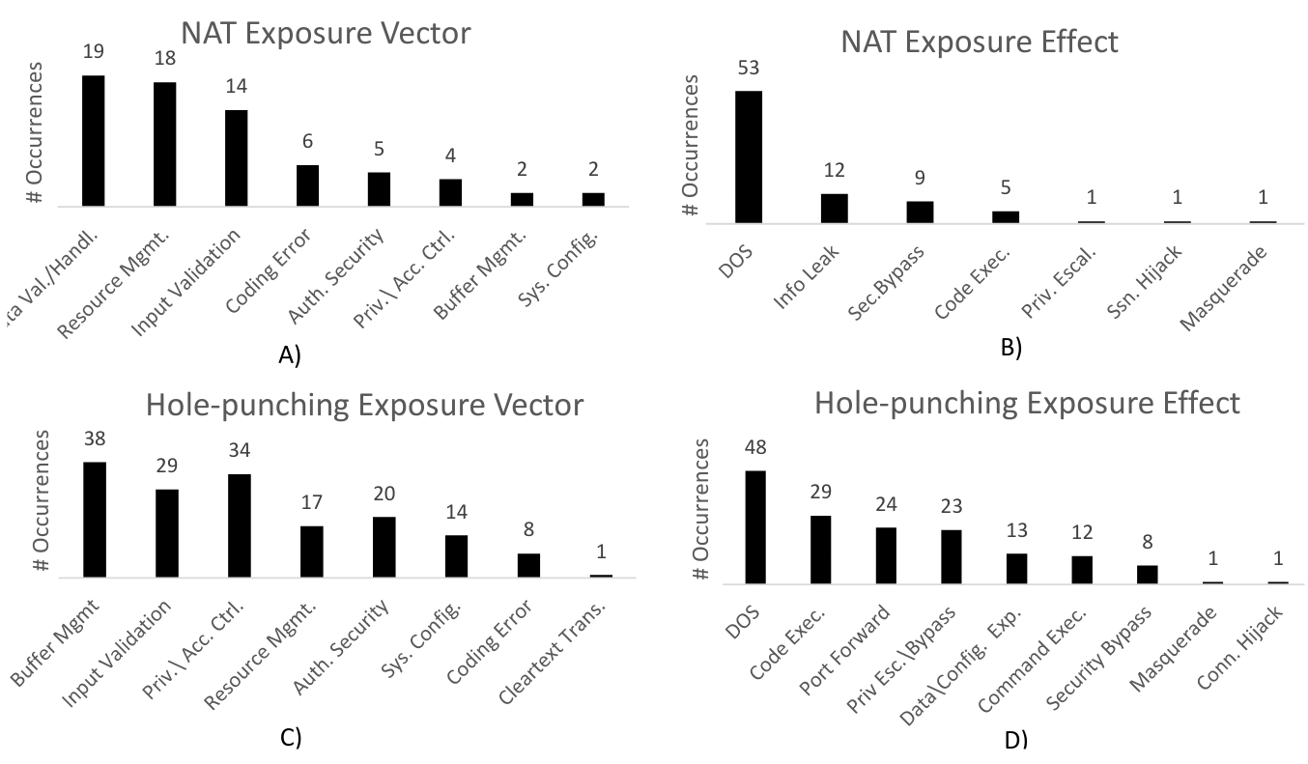
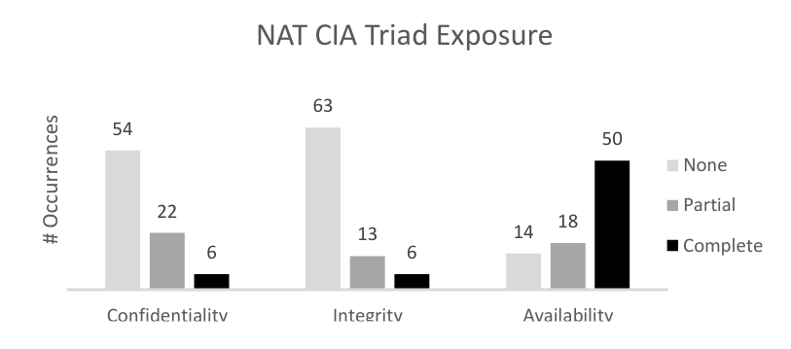
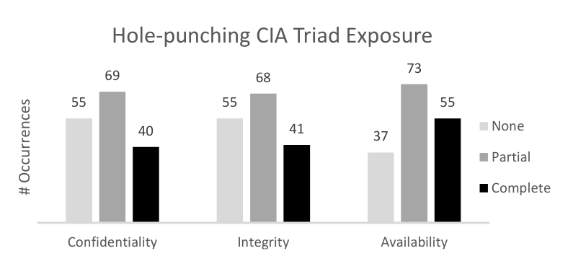
Dissertation Effort #1
How have manufacturers been incentivized for security in the past?
Security automation with hole-punching has significantly degraded the security of home networks.
Notes:
Looking at the vectors and effects, we see a wide range of exposure to consumers., which I show here on the left.
On the right is the effects these exposures have on the CIA triad. Here we see that NAT vulnerabilities typically result in a loss of availability, with little effect on confidentiality and integrity.
Hole-punching methods, however have a broad exposure across all three domains, presenting a significant risk overall.

Slide 30
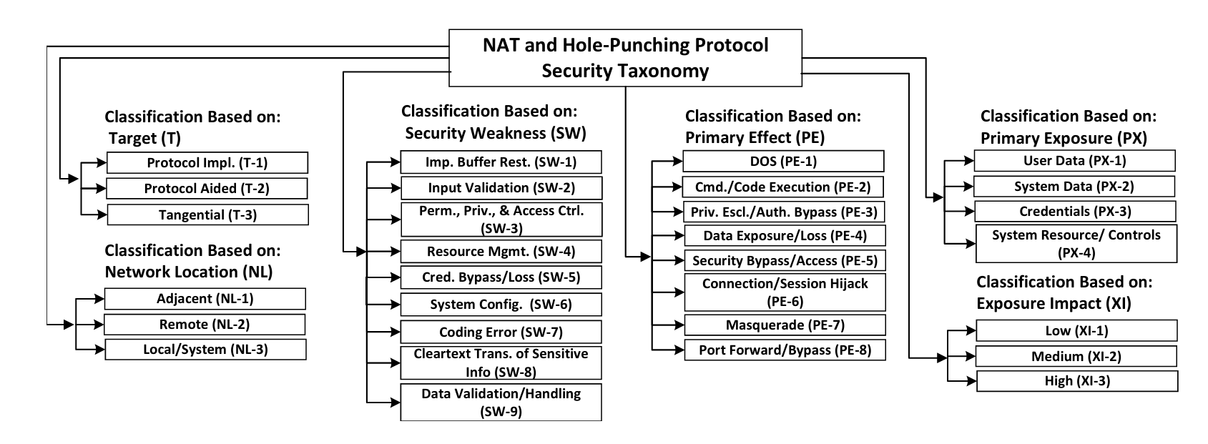
Dissertation Effort #1
How have manufacturers been incentivized for security in the past?
Notes:
From this effort we are able to contextualize the home gateway security environment into a taxonomy of security issues, which is broken down into 6 topic areas.
The first Target classification, which defines how an exposure is related to the protocol, resulting either directly from its implementation, occurring elsewhere in another system due to some unexpected change, or tangentially (define???).
Second we have the network location of how the exposure can occur. Adjacent being on the trusted portion of the network, remote external, and local on the device itself in order to execute an attack.
We then identify the weakness, or the original flaw that enables the exposure, followed by the effect of leveraging the security weakness.
Exposure then defines the primary type of information revealed by an effect.
And lastly the impact of this exposure, rated low to high. Note there were no critical flaws listed in any of these CVEs.

Slide 31
Dissertation Effort #1
How have manufacturers been incentivized for security in the past?
2010
2020
1. Reliance on outdated packages with known security issues
2. Lack of Vendor Support to Address known issues
3. NAT is not a good security mechanism
4. Security abstractions meant to ease consumer involvement commonly increase security exposure
5. Consumers typically do little to involve themselves with the security maintenance of their systems
1. Reliance on outdated packages with known security issues
2. Lack of Vendor Support to Address known issues
3. NAT is not a good security mechanism
4. Security abstractions meant to ease consumer involvement commonly increase security exposure
5. Consumers typically do little to involve themselves with the security maintenance of their systems
Address scarcity incentivized a common operational architecture, which could have served as a strong security approach, but competing incentives outweighed strong security outcomes.
Consumer Simplicity > Consumer Security
Uncertainty surrounding security ownership.
Notes:
So what have we learned here,
First, if we take a look at what challenges were with home gateways just when security was becoming a big topic, we see an environment defined by poor vendor effort to provide security, reliance on NAT providing questionable value as a security solution, greater exposure in these systems by all the additional solutions added on, especially by solutions meant to pull security away from the user and help automate things. And also low involvement by the consumer to do much about their security.
Fast forward to 2020 when we did this analysis and what we find is the same ongoing issues ten years later. So something is not working right, or more importantly, where is the incentive for security?

Slide 32
Dissertation Effort #1
How have manufacturers been incentivized for security in the past?
Main contributions:
Holistic look at access control policies in home routers, which demonstrated little evolution/change in security outcomes over time.
NAT and Hole-punching protocol security taxonomy.
Identification of CIA Triad exposure & severity for consumer routers demonstrating the broad risk and need for better security incentives.
Detailed documentation of NAT operational methods and hole-punching solutions consolidated into Journal report.
1. The desire/need for security is clearly not a strong enough incentive on its own.
2. Ambiguity in security ownership
Notes:
And so the main contributions of this effort were providing a holistic look at access control in a consumer network and understanding what this model centered around NAT has provided in terms of security over the last 20 years. Really, it is the first look at a series of protocols over their lifetime and trying to understand how we have learned and adjusted approaches to security…and the poor realization that we haven’t really moved the needle at all here.
We also provided a first security taxonomy of issues present in consumer gateways to contextualize the current operating environment, specifically focused on access control and the methods that ultimately provide or degrade security at the perimeter.
We provided a consolidated documentation of all the differences of operational methods found in NAT and hole-punching, which had previously been incomplete, demonstrating a diverse, complex, and sometimes confusing operating environment that has really challenged security overall.
More importantly, we identify that current incentives for security are either not present or not working and that we are not adapting to security lessons and improving our state, rather we are continually repeating and demonstrating the same mistakes over and over.

Slide 33
Dissertation Effort #2
Do lessons from the past serve as incentives for better security at present?
SOHO Networks
How have manufacturers been incentivized for security in the past?
Do lessons from the past serve as incentives for better security at present?
How can we better incentivize the adoption of security solutions or outcomes?
“NATting Else Matters: Evaluating of IPv6 Access Control Policies in Residential Networks”
Internet Backbone
Notes:
Building on this effort, we now look at if manufacturers are taking some of the lessons learned from NAT and if they are applying them to new paradigms, such as with IPv6.

Slide 34
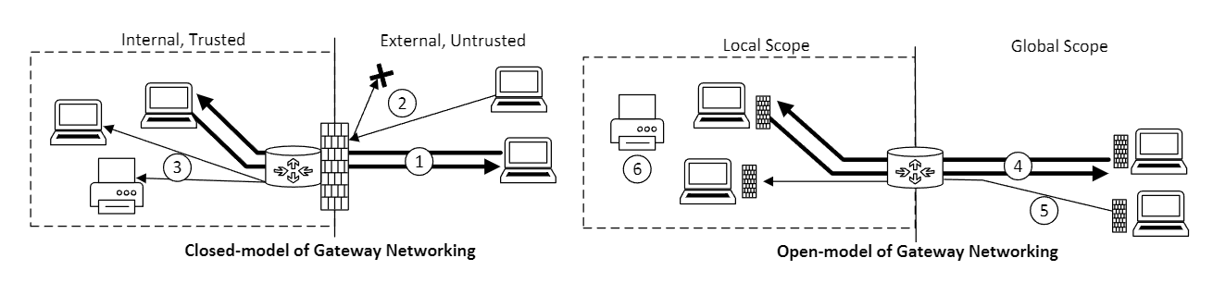
Dissertation Effort #2
Do lessons from the past serve as incentives for better security at present?
NAT Required closed model
IPV6?
Open Model – Devices are end-to-end reachable
Security falls on device
Notes:
Just to highlight why IPv6 has the potential to be a paradigm shift I present here the two models of networking.
On the left is the closed model, which segments networks at boundaries and focuses security at these edges. Within the boundary are broad zones of trust, where devices are generally freely able to communicate externally or with each other.
On the right we have the open model, where the traditional perimeter is now transparent and more in line with the originally intended end-to end design of the Internet. Here, security responsibility is placed on each device, which may or may not have the means to do so.
NAT necessitated a closed model environment simply because of its default-deny operation and use of private addressing. However, IPv6 does not require this as there are enough addresses to provide every device a unique globally routable IP meaning would could have an open model of connectivity, much like originally intended.
Which approach manufacturers will take with IPv6 is unclear and standards do little to define this space….which as discovered with NAT can create a lot of ambiguity and operational challenges.

Slide 35
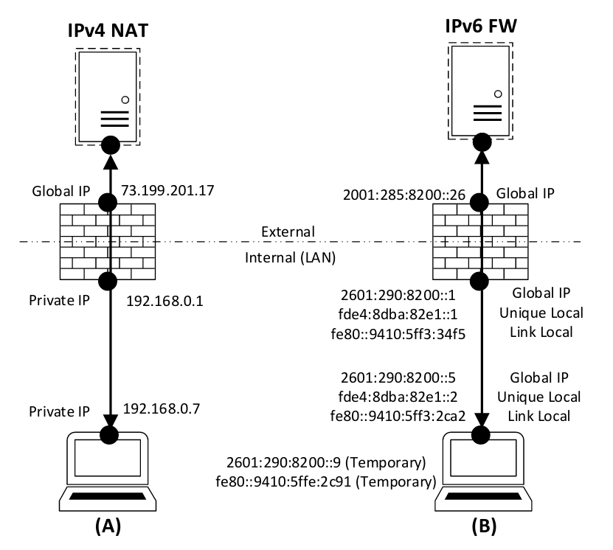
Dissertation Effort #2
Do lessons from the past serve as incentives for better security at present?
If NAT isn't great and no longer a mandatory feature....what does the security of IPv6 look like with a Firewall?
Notes:
If NAT isn’t great and no longer mandatory, what would security with IPv6 and a firewall look like.
On the left here we have a gateway, shown as a firewall, providing translation between a private IP and and external routable IP. Of note here is a 1:1 relationship of IP:Interface. Using this model, it is easy to identify a device just by its IP, but more importantly, its easy to implement rules to precisely allow or restrict access based on this 1:1 relationship.
On the right is IPv6. Here an interface can have one of many possible Ips, either a globally routable IP, unique local (which is similar to a private IPv4 address), and a link local address for point to point/link negotiation. Further, devices may utilize temporary addresses to originate connections, preventing association of IP across different activities. Great for anonymity…but how do you define a firewall for all this. More importantly, how does a consumer who has little to know understanding do this?

Slide 36
Dissertation Effort #2
Do lessons from the past serve as incentives for better security at present?
Investigative assumption:
1. Lack of requirement for NAT = lack of requirement for hole-punching mechanisms. Forwarding effectively meaningless with individual addressing.
2. Manufacturers will rely on and provide a more robust firewall mechanism to manage security under IPv6 due to no longer being forced to rely on NAT and forwarding mechanisms.
3. A default-deny policy will be present to reflect a baseline level of security, similar to that afforded by NAT.
4. Understanding of past exposures will result in better security baselines.
Notes:
We begin our assessment with a few assumptions,
First, the lack of a requirement for NAT and associated holepunching mechanisms is meaningless and that these methods would not be introduced for IPv6
Second, we expected a stronger set of controls for a firewall to cover all the difference of IPv6 and do so in a way that is easy to implement and manage.
And last, manufacturers would follow a similar baseline setup that provided a default deny policy with the IPV6 firewall, modeling a behavior expected of consumers.

Slide 37
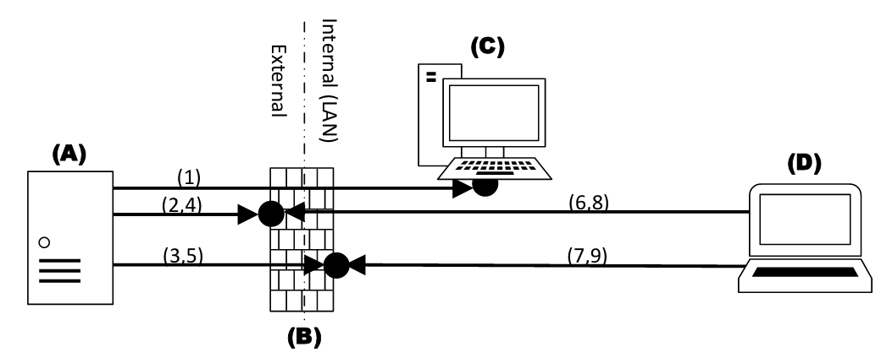
Dissertation Effort #2
Do lessons from the past serve as incentives for better security at present?
Systematically assess available mechanisms and controls:
a. IPv6 Default Behavior
b. Firewall Present
c. Firewall Enabled (default)
d. One-click open
e. Security Warning
f. Rule Generations
g. IP Specification
h. Device Specification
I. UPnPv6 Support
Notes:
To assess, we procured ten gateways and conducted a series of IPv6 scans to assess the firewall behavior and operation under varying control implementations.
The first scan was from an external point to a host located on the internal network.
The second was a set of two scans, one from external and one from the internal network against both the external and internal interfaces of the device under test. All scans were initially tested for reachability followed by a full udp/tcp port scan, Which were done to test firewall operation and differing controls.

Slide 38
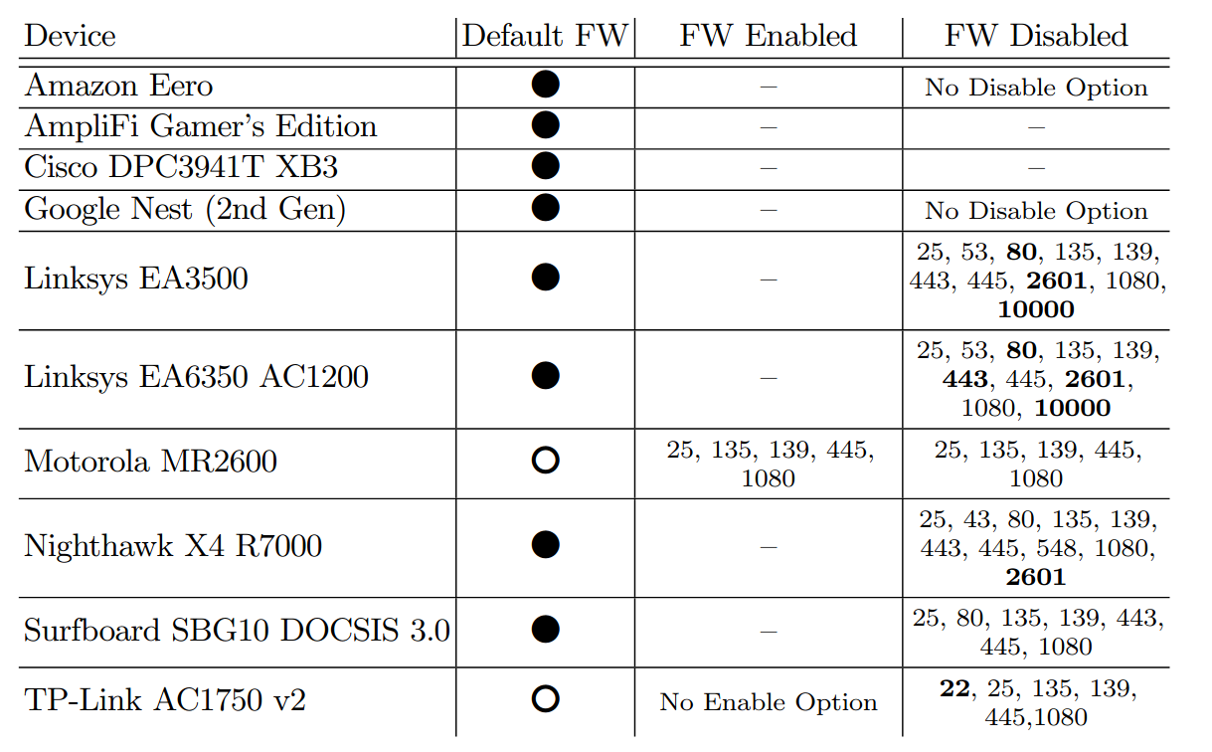
Dissertation Effort #2
How have manufacturers been incentivized for security in the past?
Do lessons from the past serve as incentives for better security at present?
Motorola & TP-Link failed to implement IPv6 controls at all.
Majority left internal network services exposed to public when firewall disabled.
Notes:
What we found was a lot of uncertainty here in device operation. Now two devices stand out in particular, the Motorola MR2600 and the TP-Link 1750. This is because these two devices chose to implement the open model of networking for IPv6, preferring to have the gateway primarily be a pass-thru device as its default behavior.
Oddly for these two, the Motorola had controls present for IPv6, but when you implemented them, they did not seem to do anything as services on the internal network were always reachable regardless of whether or not the firewall was on or off.
More glaring is that nearly all devices had services running on the internal interface of the device that were globally reachable if the firewall was disabled. With NAT, the internal interface often hosted a lot of controls for hole punching mechanisms and configuration portals that couldn’t be reached by the outside. Now, if a consumer disabled a firewall or desired to use the open model for IPv6, these services would be exposed.
Highlighted in black are ports that allowed us to perform either a telnet or ssh connection to the service.

Slide 39
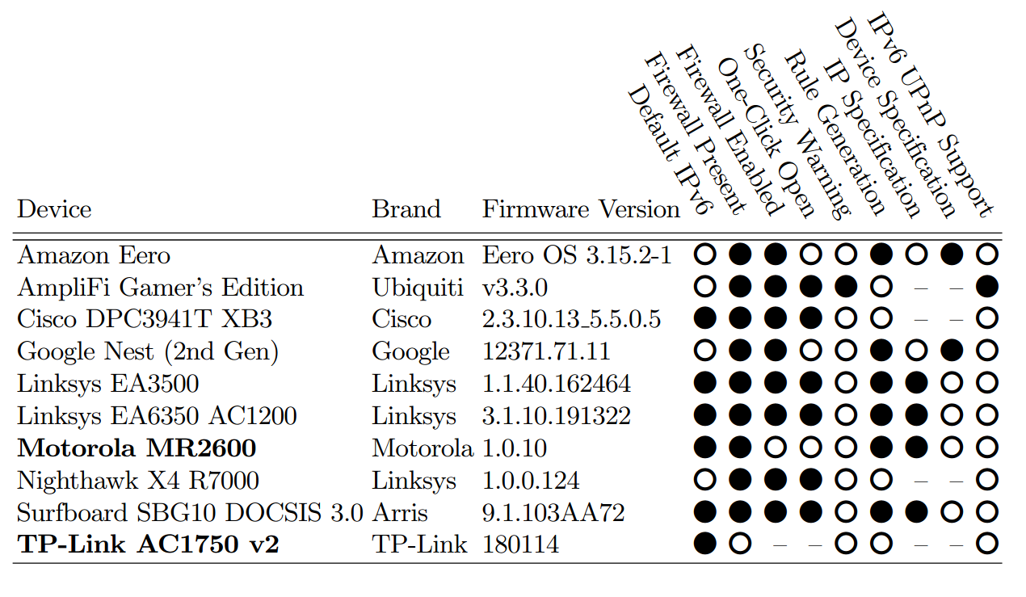
Dissertation Effort #2
Do lessons from the past serve as incentives for better security at present?
No clear operational baseline for consumers.
Many pitfalls to degrade security due to poor IPv6 Implementation.
Notes:
Looking at the controls available for IPv6, we see a wide range of differing default controls.
Over half of the devices defaulted to IPv6 operation as the system default, meaning if your ISP runs IPv6, you could be very likely running IPv6 on your network and not know it.
More interesting is how firewall rules were established for IPv6. A little over half of the routers allowed for any firewall rule creation at all. For the devices that did allow creation, four allowed specification by IP. The problem with this approach is that it did not capture the broad operation and addressing with IPv6, allowing for devices to still communicate with autogenerated Ips. Only two specified rules by identifying a device and then blocking all addresses associated with the device.
Uniquely, one manufacturer, Ubiquiti chose to implement UpnP for IPv6 as its only configuration option. Here the user could offer no input. However, they were allowed to turn the firewall off completely as their only real configuration choice.

Slide 40
Dissertation Effort #2
Do lessons from the past serve as incentives for better security at present?
Takeaways:
1. No common baseline for IPv6 operation
2. Implementations of IPv6 incorrectly rely on IPv4 design considerations (eg. 1 to 1 addressing, 1 host = 1 IP).
3. Management plane settings do not always equal precise control plane action.
4. Users may be more exposed by using IPv6 than not.
Ambiguity in standards = Ambiguity in operation.
No clear lessons being applied here for security.
Address scarcity incentivized a common operational design, but that incentive and the resulting familiarity is no longer present.
Notes:
So the takeaway here is that the familiarity afforded by NAT is no longer assured for IPv6 and that customers could have vastly different operation and controls available, many of which broadly expose the user right out of the box.
Second, we see a belief that IPv6 is just like IPv4 but with different addresses. Many of the controls present appear to take their IPv4 firewall and just add IPv6 Ips without accounting for the differences in operation. In some cases, implementing controls by a user failed to have an effect within the device.
Lastly, it appears at present that zero lessons about security are being brought forward to IPv6 development as developers are trying their best to introduce mechanisms in the absence of strong standards.

Slide 41
Dissertation Effort #2
Do lessons from the past serve as incentives for better security at present?
Hypothesizing Why so many IPv6 issues:
1. First to market incentivization
2. Patching – “We can fix it later”
3. Future Sales Incentives – planned obsolescence
4. Limited incentives to address (time, cost, image/opinion, complexity)
5. Ambiguous standards: IETF: “Leave open to manufacturers on whether or not to follow open or closed model for IPv6”
Notes:
If we consider why so many issues exist, despite decades of security awareness, we see an environment driven by business needs.
First to market provides an opportunity for manufacturers to differentiate themselves. With IPv6 we noted a number of device boxes advertising IPv6 with phrases such as “offers better security” and “add more devices to your network”, great selling points, but not really what IPv6 is primarily offered for.
With patching, its likely a mentality of “we can fix it later with a patch” is a driving factor for releases that are significantly incomplete in the devices we tested. Often IPv6 was barely functional, if at all.
3rd, a good way to generate future sales is to push customers towards new devices. It appeared that many of the IPv6 implementations were initial efforts in design, which would have to be addressed fully in either a patch or future release, likely with next years model.
Really, though there is limited incentive here to address security at all. Development is costly, ongoing device support provides little value to a business beyond maintaining customers, and the additional complexity required to build a fully fleshed out firewall may be too challenging for users in the end.
The biggest thing though is that we are seeing the same problems that NAT experienced with a lack of formal definition.

Slide 42
Dissertation Effort #2
Do lessons from the past serve as incentives for better security at present?
Conclusion:
1. Incentives for security are non-existent.
2. Repeating same mistakes.
3. Need stronger security incentivization to address.
Examples of stronger incentivization:
1. Stronger/clearer guiding standards with focus towards security. Present: open interpretations in RFCs, no defined single security standard. “should” vs. “must”.
2. Stronger consumer awareness for security/device labelling requirements.
3. Policy – GDPR, California password policy, etc.
1. Consumer guide-rails, walk them to a secure configuration
Notes:
So our takeaway here is that the incentives for security are either absent or limited at best.
We continue repeat the same lessons we have learned with NAT, almost as if we are starting over in the early 2000s again.
So something needs to be done to help incentivize better outcomes for security here.
Examples of what could work include Policy. The GDPR is one good example of policy broadly working to change an industry. Another more direct, but weak example, is the California law requiring manufacturers to require a password change on device setup/configuration. Here they passed a law requiring gateway manufacturers to implement mandatory password change on device setup. Problem is there is no fine or negative impact for non-compliance. This law was passed in 2018 and most manufacturers are still offering devices that utilize default credentials without requiring change. Only a handful appear to be complying –ASUS in particular.
We also can incentivize security with stronger guidance within standards documents. Often times these aim to be broad, allowing for broad implementation in design. But here, with security, I think there needs to be a more direct approach by the community to force change.
Last, improving consumer awareness here could help tremendously, especially if information about security guarantees are presented, much like a nutrition label.

Slide 43
Dissertation Effort #2
Do lessons from the past serve as incentives for better security at present?
Standards recommendations for a home router security baseline:
– The default operation mode should be secure, consumers should have to opt-in to less secure configurations.
– Configuration options should be consistent across manufacturers, allowing familiarity to consumers.
– Configuration pitfalls should have confirmation warnings that ensure users understand the risks associated with the changes they are making (e.g. making devices globally accessible).
- Patching should be automatic, enabled by default, and extended over life of system (Needs a universal definition).
Policy recommendations:
Manufacturers must comply with a set of defined privacy and security minimal standards (to be defined by community). Costs for non-compliance should be strong enough to incentivize change.
Device security labels - > Market incentive for manufacturer compliance and consumer involvement
Notes:
Looking at what the standards need to include, we recommend defining a clear default operation that is secure. Consumers should have to opt-in to less secure configurations. Right now it is the opposite.
We need to define a familiar operational baseline for consumers to become familiar with, regardless of manufacturer. There should be an expectation of how a device performs right out of the box. The wide variance found with IPv6 does little to offer familiarity here.
More importantly, to aid a consumer, we need warnings on changes that are likely to impact security. In many cases, turning off the IPv6 firewall provided no warning at all.
Patching should be automatic and set as a default. Right now, most systems require you to opt in, which assumes a user is actually setting up their device and searching for controls. An unlikely proposition.
For policy recommendations, we need policy that sets a defined privacy and security minimal standard in order to be sold in the US. To support consumer awareness here, security labels would help provide incentive for manufacturer compliance and help the consumer improve the understanding about their role in security somewhat.

Slide 44
Dissertation Effort #2
Do lessons from the past serve as incentives for better security at present?
Main Contributions
First home router IPv6 security assessment
Identify repeat mistakes, E.g. lack of specificity leaves open to interpretation
NAT failed to define specific operation, expectation for short life. Vendors implemented in many different ways. No standard behavior, some more susceptible to attack than others.
IPv6 failed to define specific operation (open vs. closed). Seeing same lessons of ambiguity and diverse interpretation on operation.
Got 3x manufacturers to provide system patches to remove exposures with IPv6. 1x did not do anything.
Call for industry and IETF to do better on defining requirements and enforcing
Notes:
So our big contributions here were providing the first home router IPv6 security assessment where we identified significant security pitfalls with IPv6.
We did directly inform these manufacturers of these issues and we were able to get three to quickly release a patch. One never received a patch despite a promise for it to be addressed.
More importantly, we championed a call for industry and the IETF to do better on defining requirements, because the uncertainty in many of the operation definitions leaves broad interpretation, often with an insecure result.

Slide 45
Internet Backbone (BGP)
Notes:
So for the second half here, we now shift focus to the broader internet and BGP in particular in order to understand how security solutions are being incentivized and how we can do better here.

Slide 46
Dissertation Effort #3
How can we incentivize better security solutions or outcomes?
SOHO Networks
How have manufacturers been incentivized for security in the past?
Do lessons from the past serve as incentives for better security at present?
How can we better incentivize the adoption of security solutions or outcomes?
Internet Backbone
“DnD-DB: Democratized Network Data Database for Tailored Routing and Security Campaigns”
Notes:
So we start this second half of our effort by first asking how can we better incentivize security solutions and mitigate the current drawbacks of proposed solutions.

Slide 47
Dissertation Effort #3
How can we incentivize better security solutions or outcomes?
If we cannot convince a handful of manufacturers to offer better security in their devices, how do we convince the broader internet to adopt better mechanisms?
Notes:
The challenge here, unlike with the home routers, is that we operate in a environment of distributed control, where there is no centralized operator to force change. So we really need to focus on strong incentives that will encourage adoption across a wide range of network operator goals.

Slide 48
Dissertation Effort #3
How can we incentivize better security solutions or outcomes?
New Approach
Instead of designing security solutions that impose costs, have little partial deployment value, we should focus on building solutions that help administrators perform their core functions and bring value. Use these solutions to establish conditions for security to easily be built on top of.
Proposal
Global Database of Routing Information
Why a database of routing info?
Incentivized – I get value for me right now
Focus on aiding administrators – Solves problems, eases management, aids troubleshooting
Measured vs. Validated data
Notes:
Our proposal here is to focus on the network administrator and their core business and first design solutions that help them perform their daily role more effectively or efficiently. By doing so, we can encourage adoption of systems that we can later use to introduce security mechanisms easily.
To achieve this, we propose a global routing database that administrators could use to help manage, visualize, and troubleshoot connectivity. Which sounds like a simple idea, but as I demonstrate later, can be very powerful for building new security mechanisms off of easily.
Why a database? Well we need to show value for an administrator and the things they care about. By centralizing routing information we can provide access to information that administrators need to help effectively troubleshoot their networks. This is different from centralized security architectures presented with RPKI. Here we are democratizing the data for easier access and more broadly than current designs like RIPE.
Also with this approach, we can enable degrees of trust. For example, to provide initial value, we can have the database rely on measured data to confirm things like ownership about the network. As participation grows, operators can validate this information, providing enhanced assurances and metrics by which to base security decisions off of.

Slide 49
Dissertation Effort #3
How can we incentivize better security solutions or outcomes?
What problems do administrators experience that a database would help with?
Dual Advertisement
E.g. IP/prefix site move, but not de-registered from previous location (common)
Ownership Registration Outdated
E.g. Network operator who registered data is no longer present and contact is outdated in registry (common).
Accidental use (similar to dual, but here it requires extensive troubleshooting to locate)
E.g. a prefix was loaned to another unit for event. That unit departs location and re-enables devices elsewhere without changing/returning IP prefixes (usually due to engineer changeover and incoming believing IPs belong to them.)
Accidental Overlap
E.g. Advertised a /23 but some sub/24 prefixes were utilized/advertised elsewhere unexpectedly
Route filtering
Unit joins under parent but keeps their external path. To keep traffic local, route introduced into parent and filtered from parent announcement. Mistakes on filtering do occur, resulting in incorrect routing, async, etc.
Asynchronous Routing
Orgs introduce own local-pref metrics to meet their routing needs, but create impact on others (in redundant path cases). Mainly issue because of firewalls along routes or poor performing links.
Notes:
So what are problems that administrators experience that a database of routing info could help with? I won’t cover each here, but just a few examples.
First, we have dual advertisements. So going back to the challenges with prefix hijacking, this is the same, only its by mistake. This occurs surprisingly quite often, especially in military networks. Often we move networks around monthly across the globe and sometimes we forget to deadvertise when we depart. This issue is not discovered until the next event when we discover routing challenges. Here a database could help us quickly query and identify the issue present.
Second issue is ownership registration freshness. This is a common problem. Often the ownership information about a network is tied to the original requestor….which can be over 30 years old. Efforts to contact network owners often results in dead-end information. If we could tie advertisements to administrator accounts that automatically update information based on network actions, we could help provide a platform for easier troubleshooting with external entities.

Slide 50
Dissertation Effort #3
How can we incentivize better security solutions or outcomes?
How can we provide value to administrator for their problems?
Troubleshooting
Owner Lookup (Conflicting use, transit block – who do we contact?):
Problem: Current solutions often have outdated information, are incomplete, or do not match actual implementation
Solution: Tie to administrative account that actively configures devices, update db based on config changes.
Dual-advertisement:
Problem: BGP has no mechanism to check for route advertisement conflicts and broadly allows for such
Solution: Validate prior to advertisement for conflicts (Local, proactive control)
Locate and identify conflicting route prefix/mask or parent ASN/location/contact prior to action.
Asynch Routing:
Problem: Asynch routing can cause undesirable route behavior and challenges with regional firewalls that track state
Solution: Allow for AS-Path compare to target ASN (Them vs. Us route view)
Route Leak:
Problem: Route leaks can allow for exposure of routes not intended to traverse network, allowing for attacks or unexpected routing
Solution: Announce/Alert Route changes
Policy vs. action comparison, visually show route announcement

Slide 51
Dissertation Effort #3
How can we incentivize better security solutions or outcomes?
How can we provide value to administrators for their problems?
Management
Route visualization and testing:
Utilize AS-PATHs to determine primary and alternate routes (from table).
Can visually represent primary/alternate paths and validate topology before action.
Introduce Automation for Actions:
Tie Database actions to configuration changes at ASN
Helps maintain fresh data.
Other troubleshooting:
Can pre-populate Db with various measure data to provide value to local admin for lookup/troubleshooting. E.g. Administrative, outage, link status, etc.
Value
Provide opportunity for new routing paradigms (Secure implementation, trust, country, etc.)

Slide 52
Incentivizing through prioritization of value: SLA-based Optimization Example
Dissertation Effort #3
How can we incentivize better security solutions or outcomes?
DB
Scenario 1 - Optimize here based on my stored DB info.
Me
- Select routes with published security deployments.
- Validate path against published topology
- Verify ownership
A
C
Scenario 2 - Optimize here…
Incorporate Security Later
B
Scenario 3 - Optimize across topology based on complete DB sharing/ information
1
2
3
4
5
6
…based on others shared DB info from here.
7
8
9
10
Notes:
To demonstrate how a provider could leverage a global DB for their use, we highlight three deployment scenarios covering different rates of participation.
Scenario 1 – We can leverage information that we have locally measured, in conjunction with global measurements to make decisions on local forwarding. So for example, we may know that a “B” reaches saturation every evening resulting in SLA violations. Normally we would forward along C in these instances, but today that link is down due to maintenance. Path A has latency that effects a small portion of SLAs. Given this information, requirements, we can optimize local forwarding to ensure we are meeting our local SLA requirements at all times.
Scenario 2 – We expand, but now we can begin to utilize information that is being reported by others in our local decision making. For example, maybe node 5 has reported a capacity limit as an alert to the database, we can use this info to shift forwarding patterns, potentially helping 5 and our own customers avoid SLA violations.
Scenario 3 – With broad participation, we can now start to leverage data to optimize across a topology with new route selection and forwarding methods.

Slide 53
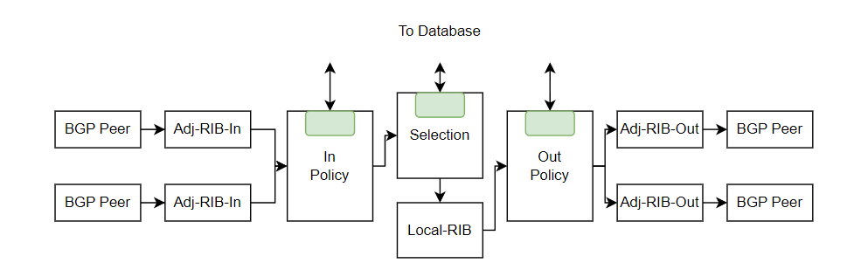
Dissertation Effort #3
How can we incentivize better security solutions or outcomes?
Architecture
1
Global Routing Database
Routers can leverage in-network processing to make routing decisions
Local off-line processing can be used to support management tasks
2
3
Notes:
How would this global database of information work?
First we have the global database, marked by 1.
Here routers could leverage in-network processing utilizing the database to either provide updated information to the database or pull information to base routing decisions off of. Opportunities for routers to make decisions can occur in one of three places in the BGP processing pipeline, shown at the bottom at either the input or output policy controls or at the route selection process.
Local offline processing, marked by 3, could also be used to support other management tasks, such as providing network visualization, testing/validation, or troubleshooting capabilities where the global database information can be used to support local needs.

Slide 54
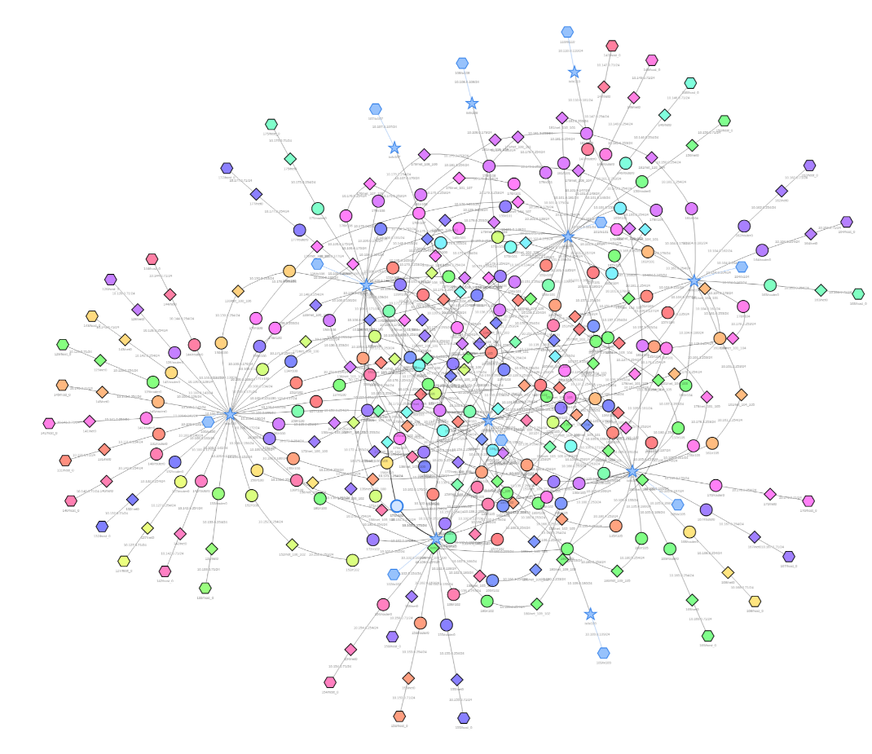
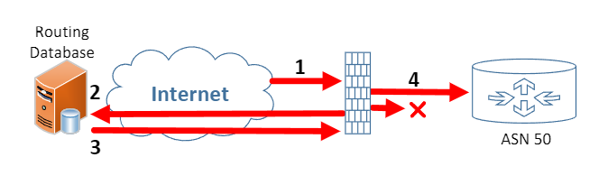
Dissertation Effort #3
How can we incentivize better security solutions or outcomes?
Docker Container
Simulated 53 ASNs, 195 Containers, using CAIDA AS-Neighbor Dataset
Average AS_Path 2.63 Nodes, max 5 (Internet ~5, max 13)
MongoDB Global Database, public & private record for each ASN
Proxy packet processor
Notes:
Rather than editing BGP directly, we relied on a proxy concept built around scapy and netfilter to demonstrate a proof of concept. Here the router was established in a docker container utilizing the BIRD routing daemon and the proxy was included in the same container allowing for easy capture and parsing of network traffic prior to forwarding to BIRD router.
All of this was then deployed in the SEED internet emulation environment, which allowed us to rapidly test and scale our architectures. Here on the right is a small scale architecture consisting of stub, transist and internet exchange points, representing a small scale internet. This one had about 25 routers and about 25 host containers. However, we have simulated up to 500 routers in a single environment to test our solutions at larger scales.
To deploy our environment, we simply defined the toplogy size and percentage of routers we wanted to deploy the proxy on. Once the environment was up, the systems with proxies would begin intercepting all inbound and outbound routing advertisements, validating them against the Ethereum database, which was pre-populated with network ownership data that was autogenerated based on each topology.
So looking at 1, as a routing advertisement came in to a router, the proxy would intercept it, conduct the call to the blockchain at 2. The blockchain would check the database and provide either a valid, invalid, or not found response. Based on this information, the proxy would either accept the advertisement and forward to the router, or strip the bad information out of the packet before forwarding the remaining information.
One thing that comes up when you simply strip information is that TCP sequence numbers no longer are in sync with the distant end, so we made the proxy account for this and handle all tcp sequencing information, ensuring that the topology remained in sync. If you did not have this, the routers would constantly reset their connections.

Slide 55
Dissertation Effort #3
How can we incentivize better security solutions or outcomes?
Record_id (public)
ASN: {ASN#}
Adv_network_public:[]
Network: {Prefix/Mask}
Age:{mm:dd:yyyy}
Validation:{defacto,registered}
Contact:{Org, phone, etc}
Security:[]
RPKI: {yes/no}
Neighbor Segments:[]
Segment ID:{Remote_ASN}
Local ASN: {Local_ASN}
Transit Type: {peer, provider, customer, stub}
Transit Cost: {rate}
Age:{mm:dd:yyyy}
Country: {Country}
City: {City}
Routes: []
Network: {Prefix/Mask}
AS_PATH:{AS_Path}
Selection:{Primary/Alt}
Age:{mm:dd:yyyy}
Record_id (private)
ASN: {ASN#}
Link: {Local ID}
Latency:[]
Current: {ms}
Historical: [ms]
Throughput: []
Current:{rate}
Historical:[rate]
Adv_networks_private:[]
Network: {Prefix/Mask}
Age: {mm:dd:yyyy}
Contact: {Org, phone, etc}

Slide 56
Dissertation Effort #3
How can we incentivize better security solutions or outcomes?
Experimental Approach:
1. Demonstrate Value
2. Demonstrate Equivalency
3. Estimate Performance Requirements
Notes:
To test our architecture, we approached our experiments from three vantages. First we wanted to show that we could demonstrate value – our key incentive that would help encourage adoption by showing value to an administrator.
Second we wanted to demonstrate equivalency, by showing how our approach could offer security on par with present approaches, yet offer broader opportunity
Third we assess performance to establish the requirements for a global database design.

Slide 57
Route Selection Based on SLA Cost:
Dissertation Effort #3
How can we incentivize better security solutions or outcomes?
Demonstrate Value:
ASNs randomly selected to report transit costs to global DB.
Routes assessed from a measurement node (modeled after Cloudflare).
Compare to Default BGP Selected route.
Notes:
So for our demonstration of value, we randomly selected ASNs to report their transit costs according to our chosen topology deployment rate (e.g. 10\% represented 10\% of peer-to-customer links reporting transit costs) using publicly reported transit costs for 10 Gb/s links in North America. Since actual transit costs can vary based on overall throughput of a link, we assumed a constant 85\% usage rate. Future design iterations could account for dynamic price changes relating to traffic rates, if needed.
We then regenerated route announcements by resetting the bgp process for each node in our topology, measuring the received BGP Updates at our measurement node. For each update, we would check the AS_Path of the route, calculate the transit costs based on reported data to the database, and then compare the route to the current best selected route in the routing table. If the measured route was lower cost, we would utilize the bgp communities string to inject a value that the router would then use to prioritize this route for selection.
Presented you see the results of this this experiment. On the left we note two things. The bottom blue line shows that about 10% of the time, there was a cheaper alternative route available compared to the default BGP selected route, resulting in an average of 10% savings. Also the top line shows that 40% of the time, there was a cost equal route present, showing that there is wide availability in selecting alternative routes to meet SLA requirements while maintaining costs.
To achieve these benefits, typically only one additional hop was required, which introduced minimal latency….a concern for SLAs.

Slide 58
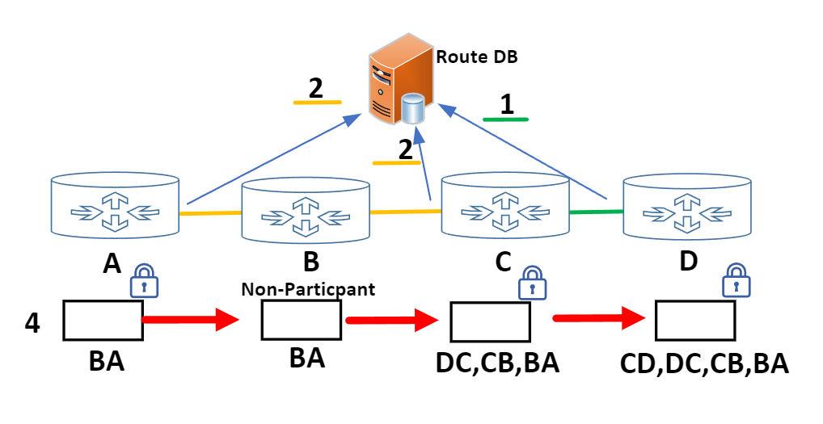
Dissertation Effort #3
How can we incentivize better security solutions or outcomes?
Demonstrate Value:
Topology and Path Validation:
Notes:
So what else can we do with this concept?
Well if we recall BGPsec which required an unbroken chain of signatures to validate the path, there is little incentive there to ever deploy because it is unlikely we would every get to the large adoption rate needed to demonstrate value.
However, using a database we can come up with another approach.
Here, routers could register network segments between them and their neighbors. This information could get stored in the global database, which others could then use to verify path information.
However, instead of all or nothing approach, we could instead introduce degrees of security.
So on the left here, b is a non participant, who would normally break the validation chain and cause the route between A and D to revert back to no validation at all. However, using the DB, we can use A’s information saying they are connected to B and C’s information saying they are connected to B to provide SOME level of assurance that the path from A to C is connected by B. This is better than nothing. Further, we could add in network timing measurements to validate that B is not sending elsewhere first, adding another level of certainty. In this regard, we could theoretically provide a path validation mechanism with just over 50% participation (best case). Even without, additional data and metrics allow for us to provide some level of assurance about a path, paving the way to better security which in turn helps further incentivize adoption.

Slide 59
Dissertation Effort #3
How can we incentivize better security solutions or outcomes?
Demonstrate Value:
Notes:
Following a similar approach to the SLA cost comparison, we now validate the percentage of an AS_Path validated against varying participation rates and reporting to our database to show the opportunity to select routes based on validated participation.
A few item of interest here. In the top left I show three scenarios of route selection compared to the default BGP approach. The grey line shows the percentage of routes that could be selected that had an overall validation rate greater than the default. While the yellow shows the percentage of routes with equal validation. Using this approach, there is opportunity here where a provider could leverage these results to provide a new tier of service based on overall route validation.
More interesting is that nearly 100% of prefixes had a route where the entire path could be validated (blue line top left and yellow bottom left) using the single non-participant approach, providing some measure of assurance and demonstrating how there is value in establishing differing degrees of security. These route could be selected at the same path length as the default BGP route (top right).

Slide 60
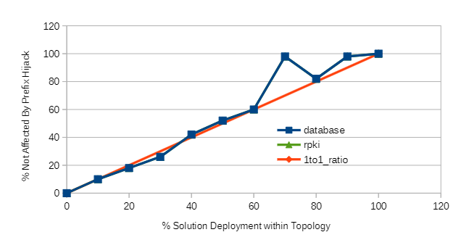
Dissertation Effort #3
How can we incentivize better security solutions or outcomes?
Demonstrate Equivalency:
Comparison to RPKI:
1. Nodes randomly selected for deployment and recorded to redeploy comparison approach on.
2. Launch prefix hijack, record routing table results for presence of hijacked route.
Note: Value below 1to1 line reflect a rounding reduction for random selection. Values above reflect security being extended to downstream non-participants.
Notes:
When comparing our design to RPKI, we were able to demonstrate a 1:1 equivalency. Here the RPKI data is hidden behind the blockchain data.
A few points of note, we did discover instances where even though RPKI was deployed, our traffic could still end up being misrouted due to another system in our network path being effected. This is shown in the dip below the 1:1 line. Also, we can have broader protections when key locations in the network are protected and by extension protect networks who have not implemented RPKI, this is shown in the portion above the 1:1 line.
However, the key takeaway here is that our PoC is able to demonstrate security on par with RPKI while allowing for additional opportunities.

Slide 61
Dissertation Effort #3
How can we incentivize better security solutions or outcomes?
Assess Performance:
Measured processing times across varying rates of updates being received.
Used steady state throughput to calculate queue capacity and peak processing rates.
Notes:
For our third effort, to measure performance, we measured the processing throughput of the proxy for a single lookup validation, such as with ROV, and a multi-lookup event, such as validating the path. We then measured separately this combination, to reflect an average BGP Update validation, which we then use to assess overall throughput capacity for update rates. We also use this to calculate the queue capacity using a 1000 packet queue, shown on the right.
Few things of note here, as expected, latency has the largest effect on the overall throughput capacity being the largest percentage of time required to validate information in a packet. Which demonstrates that careful consideration is needed for a global database design and strategies to reduce this cost will be important. Using a local cache of information does alleviate this concern, but does impose additional costs such as management of systems and added complexity.
Overall, we had maximum throughputs of 16, 27, and 80 updates/sec for the various latencies.

Slide 62
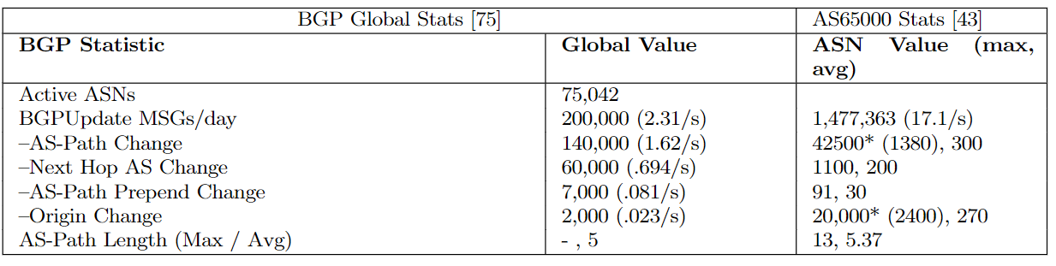
Comparing to global metrics:
Dissertation Effort #3
How can we incentivize better security solutions or outcomes?
Assess Performance:
Notes:
How does that compare to global statistics?
We looked at two datapoints for this. First, the average global value, which is approximately 200k updates/day or 2.31 updates/sec.
However, looking more closely at a single node (this being a very central, well connected node), we see locally that the update rate can be much greater. Here the average was about 17.1 updates/sec with a peak of approximately 67k updates/sec for major events occurring. So while our design is capable of handling the average, peak rates go beyond this capacity. However, in a few slides, I will talk about ways to alleviate this concern.

Slide 63
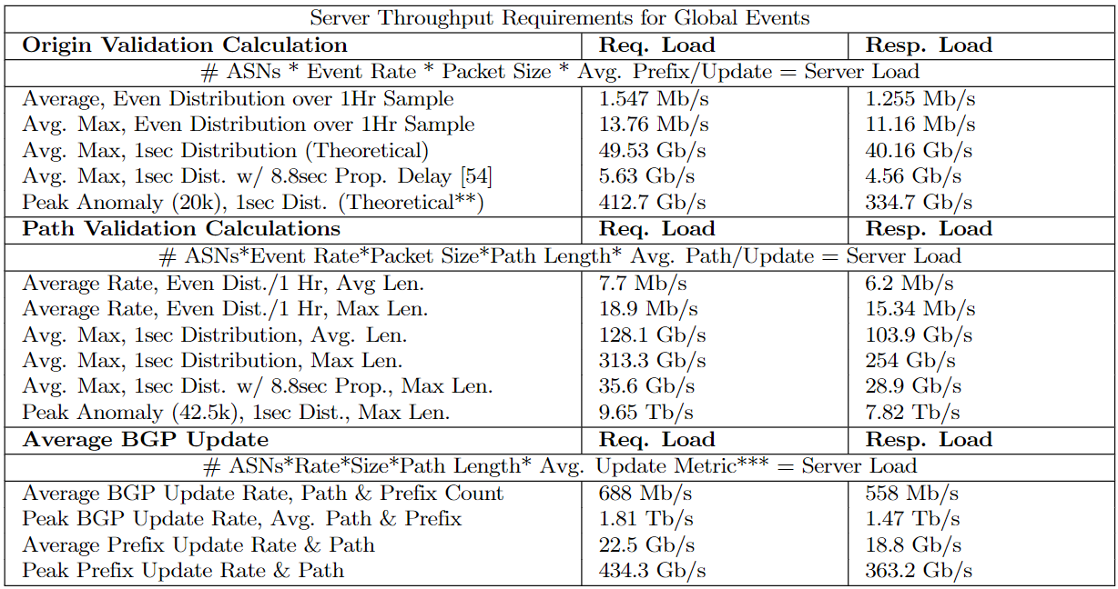
Global DB Network Requirements:
Dissertation Effort #3
How can we incentivize better security solutions or outcomes?
75042 ASNs*2400Updates/s*275bytes=49.53 Gb/s
1
75042 ASNs*1380 Path chgs/s*275bytes
*11 AS_Length=313.3 Gb/s
2
3

Slide 64
Measuring Server Load:
Dissertation Effort #3
How can we incentivize better security solutions or outcomes?
Assess Performance:
Topology Generated Traffic Approach
Traffic Generator Direct Approach
Average BGP Update Metrics: 173,347 Req/sec
Peak Event BGP Update Metrics: 4.7B Req/sec
Notes:
Looking at the server’s ability to process we note a few things. Using the average topology metrics, we calculated how many updates should be received and generated to the server (green line). We then generated traffic using two approaches, the first was the router reset method, which generated representative network traffic due to propagation along multiple routes, much like would occur on the internet. However, this approach was limited as we tried to generate higher rates of traffic due to portions of topology dropping before complete bgp update propagation could occur (pink line deviance from the green).
To get a better assessment, we then built a traffic generator to directly measure server throughput, which reached a steady state of approximately 11k req/sec (grey line).

Slide 65
Dissertation Effort #3
How can we incentivize better security solutions or outcomes?
What Approach Demonstrates:
Provide value up front to incentivize adoption
Demonstrates opportunity for additional value to grow
Can leverage opportunities to increase initial value (measured data vs. reported data)
Feasible design
Discussion:
Opportunities for Processing Improvement
Router Integration
Table Action Validation Only
Local Cache
Distributed Architecture
Minimize latency
Local Cache
Redundancy
Record Size (#’s)

Slide 66
Dissertation Effort #3
How can we incentivize better security solutions or outcomes?
Main Contributions
Proposal for new BGP security approach that focuses on deployment incentives.
Working prototype design using proxy/db to demonstrate feasibility and functionality
Demonstrated equivalent designs to RPKI could be implemented while greatly increasing incentives for adoption
Demonstrated how new security paradigms could be built on top of routing database with a proof-of-concept measurement based on security deployment.
Notes:
And so our main contributions in this paper are proposing a new approach to BGP security that focuses on deployment incentives by focusing on providing value to administrators first, and then building security methods off those solutions.
We built and tested a blockchain/proxy based approach to demonstrate feasibility of our solution and that we could achieve results on par with current security mechanisms but with better adoption value and also introducing the concept of degrees of security for value.

Slide 67
Conclusion
Conclusion

Slide 68
Conclusion
The desire for security is not a strong enough incentive on its own.
To achieve better security outcomes, we need stronger security incentives.
#1 – Impose costs to reprioritize security.
#2 – Incorporate incentives into designs to encourage better adoption.

Slide 69
Questions?

Slide 70
Background – Home Networks
Network security using NAT and NAPT (M. Smith 2002)
NAT provides an "Appropriate" level of security for consumers. Firewalls likely too complicated.
Brave New World: Pervasive Insecurity of Embedded Network Devices (A. Cui 2009)
SoHo security is a pervasive issue.
Vendors show little effort to address
Security Flaws in Universal Plug and Play: Unplug, Don't Play (H.D. Moore 2013)
Abstractions to security management carry own security problems. Demonstrated scale of problem and vendor reliance on outdated software packages.
Towards Automated Dynamic Analysis for Linux-based Embedded Firmware (D. Chen 2016)
Automated analysis of SoHo firmware. Use of code-sharing and open-source libraries prevalent across vendors – flaw in one = flaw in many. Who is responsible for updates?
Takeaway: We have intentionally abstracted security away from the consumer while simultaneously providing them with insecure systems. No clear responsibility for security.
Notes:
So how did we get here?
Going back to 2002, one of the first papers looking at the security value of NAT identified the default-deny security posture of address translation as providing an “Appropriate” level of security for consumers. And for that time, this was likely true.
Interestingly, the authors also noted that stronger security mechanisms like a well configured firewall were likely too complicated for the average user to implement and maintain. And that again is likely a valid position, especially in light of the previous slide showing consumer participation in security.
However, moving forward a few years we start to see some of the early home router security assessments which show two things. 1) Security within in SOHO routers is a pervasive issue, often having insecure default configurations, outdated packages, default passwords, with little effort by manufacturers to address these security gaps. More importantly, the process to fix these solutions were often complex for the user to perform. E.g. format usb drive, download firmware, perform router reset, and let router update and hope things worked out – or more precisely a very intensive user effort to correct. This effort was in stark contrast to many of the manufacturers efforts to abstract involvement away from the user through minimal controls, and automated mechanisms to ease security management.
In the 2013 paper by HD Moore, this paper discovered that many of the solutions vendors were implementing to abstract security away from the user and ease security management actually had the opposite effect of increasing the overall system exposure due to the vulnerabililities in the packages used to implement these abstractions. Further, he discovered that many of the systems were being sold with long outdated software packages – meaning secure solutions were available, but manufacturers were not implementing them.
Then the 2016 paper by Chen performed a large scale analysis of router firmware, showing that many vendors were utilizing large portions of open-source code which they were then modifying for their application specifically. Notable here is the realization that a single package flaw could have wide ranging effects across the internet. This also introduced an interesting question of who owns the ultimate responsibility for updating systems? If open source libraries are the primary solution for router firmware, did the router manufacturers here have any legal responsibility to maintain systems?
The end takeaway here is that we have abstracted security away from the user while also providing them with insecure systems that they are ill equipped to control & harden. More importantly, there is no clear owner for security responsibility.

Slide 71
Prior Work
Assessing BGP Security
A Survey of BGP Security Issues and Solutions (K. Butler 2010)
Security solutions present high costs to operators (hardware, design, management)
Rely on centralization of trust
Incremental and partial enhancements due little to solve larger issues (low incentive)
An Infrastructure to Support Secure Internet Routing (RPKI) (M. Lepinski 2012):
Use of PKI to sign and authorize ownership and route advertisements
Securing BGP with BGPsec (G. Huston 2011):
Use of signatures to sign forwarding information – Path validation
Securing Internet Applications from Routing Attacks (Yixin Sun 2020):
Applications can incentivize secure routing solutions
Applications may provide focus necessary to enact change
BGPcoin: Blockchain-Based Internet Number Resource Authority and BGP Security Solution (Q. Xing 2018)
Distributed security solution – but largely a blockchain-based recreation RPKI
Reliance on certificate authorities and validation
Takeaway: Solutions exist, but introduce heavy costs to people who would implement. Value occurs after wide adoption. Little incentive for me now. Cost>Immediate Value.
Notes:
Looking at how we got here,
The 2010 paper by butler noted that security solutions being proposed for BGP all presented high costs to operators to install and maintain. Further, the solutions being presented worked against the design goals of BGP, which was a decentralized architecture where no one in particular was in control. Introducing solutions which centralized this design direction seemed to go against BGP principles.
So what did we do with this information? We went ahead and proposed more solutions that did the opposite of what this paper called out as issues with BGPsec and RPKI. So its no surprise, that adoption has been a challenge here.
Looking at incentivization for better security, the 2020 paper here noted that rather than looking internally for direction, external factors such as applications could be an emerging approach for incentivizing BGP security. Here, application requirements for secure routing could be a driving factor to force some level of change on underlying routing. An example of this could be ToR, where routing overlays help build security by mitigating exposures of underlying network systems. (not perfect).
We have also looked to blockchain as solutions, removing the centralized aspects of many BGP security methods, however, these commonly still follow the same pitfalls found with partial deployment and lack of early incentives for adoption.

Slide 72
Dissertation Effort #2
Do lessons from the past serve as incentives for better security at present?
Home networks have no clear security implementation incentive
Standards do not do a good job of defining clear security requirements
No accountability mechanism to force compliance
Solutions and mechanisms exist, but are not being applied correctly or at all
Unclear consumer role – no expectation for involvement
Need stronger standards and/or regulation to incentivize better outcomes.
Notes:
The takeaway here in closing this first section is that we are clearly missing incentives to support security implementation. After 30 years of home router development, we should be seeing much better outcomes at this point.
Right now business focused incentives are driving the design of these systems and those incentives often work against providing a strong security baseline. Lack of consumer involvement and understanding is also helping these manufacturers shape initial delivery that is widely insecure.
This self governance model is not working and the single biggest incentive we can offer for security is through stronger standards and regulations that impose business costs for non-compliance.

Slide 73
Dissertation Effort #3
How can we incentivize better security solutions or outcomes?
What problems do administrators experience that a database would help with?
Stability
SATCOM/Fiber inherently unstable, untested alt paths can introduce unexpected routing headaches (local-pref/length/filtering)
General Military Challenges
We move/build/tear down networks weekly at varying scales unlike an ISP. Therefore, we run into the above problems much more frequently than a “stable” architecture. While military units do have their own ASN assignment, often times they will fall under a parent who will host IP space for them. Constant churn of engineers (typical assignment 2 years), makes it easy to lose understanding of where things are assigned and what they are used for.

Slide 74
Other Projects/ Efforts
Workshop Papers
Title: Infinity: A Scalable Infrastructure for In-Network Applications Conference: IEEE International Symposium on Integrated Network Management 2021. Research Effort: In-network compute resources are commonly fixed, resulting in a limited or inefficient use of resources for things like edge computing. While computers typically have abstractions that can scale resources efficiently to meet application needs, these same abstraction do not currently reside in network compute capabilities. This paper proposes an approach to scale in-network resources either horizontally or vertically in order to meet the growing compute demands of in-network processing. Authors: Abranches, M., Olson, K. Keller, E.
Title: Enabling Security Research through Efficient Partial Deployment Topology Configuration and Validation Conference: IEEE INFOCOM Computer and Networking Experimental Research using Testbeds (CNERT) Workshop 2023. Research Effort: Measuring partial deployment value of a security protocol at internet scale is an impossible problem due to uncertainty in network design and challenges establishing the necessary resources to fully simulate. We present an approach to measure partial deployments quickly and easily and demonstrate our solution utilizing RPKI. From this we show that RPKI requires large adoption rates greater than 70% before the internet will broadly begin to realize the value of RPKI. Authors: Alharbi, B., Olson, K. Keller, E.

Slide 75
Other Projects/ Efforts
Posters
Title: All Your Data Are Available to Us: A Need for Network Segmentation with IoT Devices. Conference: Networked and Distributed System Security Symposium (NDSS) 2020. Research Effort: This project investigated segmentation within home networks and IoT devices. While protocols like Universal Plug and Play provide for automatic configuration for hole punching in a gateway, they do not provide capability to segment network access within the local network. This presents broad network exposure within the home where everything operates within a shared trust environment. This project proposed building into the UPnP protocol methods to automate the segmentation of IoT devices within the home and prevent this exposure. Authors: Olson, K. and Scaife, N.
Title: Federating Trust: Network Orchestration for Cross-Boundary Zero Trust. Conference: ACM Special Interest Group on Data Communication (SIGCOMM) 2021. Research Effort: This project proposed an approach to federate Zero-Trust decision properties across disparate network standards. By utilizing a proxy handler, networks could coordinate access standards for users without revealing information about the local security environment to the external entity. This approach would allow companies to maintain threshold security standards necessary to meet security goals of Zero-trust across boundaries, even if they did not have any say in the remote networks security standards. Authors: Olson, K. and Keller, E.

Slide 76

Research Effort #3
How can we incentivize better solutions or outcomes for security?
Root IANA Smart Contract
ASN Contract
Netwk 1
Netwk 2
…
Notes:
On the blockchain, we implemented a number of smart contract actions that we could use to both establish the environment and support its operation.
First we established a root contract, representative of IANA, which owned all the IP prefixes. As part of this contract, we then deployed ownership accounts for each ASN in our topology. Finally, we delegated prefixes from the root contract to the ASNs using our Add_prefix action.
The proxies would then use a validate prefix action to validate each of the incoming advertisements, which would check the ASN account information and search for a matching prefix before returning a response.
We also created a number of administrative actions that we could use to help check and validate information such as Get_prefix_owner and Get Prefixes Owned.

Slide 77


Research Effort #3
How can we incentivize better solutions or outcomes for security?
Modified SEED Internet Emulator

Slide 78

Research Effort #3
How can we incentivize better solutions or outcomes for security?
Demonstrating new security paradigms: How many routes with one or 50% of RPKI deployment?
Notes:
One of these opportunities is that we can determine routes which have systems running RPKI on them. This in turn could be used by the routers to select routes specifically based on security objectives. Here we show the percentage of routes in a topology that have just one router running RPKI vs. 50% of a route running RPKI.
From a business perspective, this could add potential incentive to offer things like premium services based on customer requirements.

Slide 79

Research Effort #3
How can we incentivize better solutions or outcomes for security?
Mediocre Blockchain Performance (Expected)
Notes:
Looking at performance, however, the solution is not that great. We were able to support about 25 proxies on a single blockchain before the performance of the network dropped significantly and the delays in processing packets started to introduce network issues and outages. This was somewhat expected as utilizing an Ethereum blockchain has a low throughput and would not be an ideal approach for network scale solutions. That said, there are a number of directions here that could be used to achieve potentially internet scale, with new blockchains specifically designed for rapid throughput, or architectures, such as a blockchain of blockchains, that would allow localized performance with tiered architecture to meet internet scale needs.

Slide 80
Research Effort #4
“Future Work: Routing Database to Incentivize Security Deployment in BGP”
How have we evolved approaches to security over time in consumer gateways?
How are manufacturers taking lessons from the past and applying them to new paradigms?
What would an incentivized security solution look like?
Can we demonstrate both equivalency to present solutions and opportunity for new methods in our design?
“Doomed to Repeat with IPv6? Characterization of NAT-centric Security in SOHO Routers” – ACM Computing Surveys ‘23
“NATting Else Matters: Evaluating of IPv6 Access Control Policies in Residential Networks” – PAM ‘21
“Where is the Incentive to Secure the Internet?” – ACM Hotnets ‘23 (Under Submission)
“Future Work: Routing Database to Incentivize Security Deployment in BGP”
Notes:
And for my last effort, we look to build off the previous work with a few enhancements.

Slide 81
Research Effort #4
“Future Work: Routing Database to Incentivize Security Deployment in BGP”
Proposal:
Convert current blockchain database to one more appropriate for internet scale processing and demonstrate working routing database prototype.
Finalize and establish database information hierarchy/structure.
Show RPKI equivalency in design/operation in simulated environment.
Measure performance characteristics and extrapolate to internet scale requirements.
Provide clear Incentivization and strengthen value rationale
Define next step opportunities, directions, system components for future research/implementation.
Package findings into conference submission paper.
Notes:
For this I am looking to convert the current blockchain based approach to something more appropriate for internet scale processing and demonstrate a working solution here.
I would also look to expand and define a number of larger database structures that could be used to enhance value beyond just prefix validation. So we could include things here such as ownership registration that is tied to router configuration actions, router location information, etc.
Most importantly, conduct a series of tests to measure performance characteristics and then determine what this would take to meet internet scale requirements.
And finally, package this all up into a conference submission paper along with further directions for research opportunities.

Slide 82
Timeline
21 September
1 November
1 December
14 December
Proposal Presentation
Finish Research
Finish final paper/chapter writing
Defend Dissertation
Notes:
Timeline I am looking at is finishing up all the research by 1 November to give me time to write the final chapter/paper, and then conducting the defense on 14 December.

Slide 83
Research Effort #4
“Future Work: Routing Database to Incentivize Security Deployment in BGP”
API_Name{Input}: Description of action
Administrative Actions:
Get_ASN {Prefix/Length}: Returns associated ASN for a given prefix
Get_Prefixes{ASN}: Given ASN value, return list of prefixes associated
Register_ASN{ASN}: Checks for conflict, Creates new ASN# in database
Register_Prefixes{ASN, Prefix/Length}: Checks Prefix/length against all ownership for conflict, Registers new prefix to ASN (no conflict)
Remove_ASN {ASN}: Removes ASN and returns all prefixes to root (IANA)
Remove_Prefix{ASN, Prefix/Length}: Removes prefix from ASN ownership and returns to root (IANA)
Request_Contact{Prefix/Mask}: Returns contact details of prefix owner
Register_Contact{Prefix/Mask}: Registers contact details of prefix owner
RPKI Actions:
Validate_Prefix{ASN, Prefix/Length}: Conducts check for match, returns {valid, invalid, not found}
Register_RPKI_Status{ASN, Status}: Registers in Db status of RPKI usage by ASN
Path Validation Actions:
Register_Segment{Local_ASN, Remote_ASN}: Checks for matching return segment and either registers new segment or fully validates segment.
Validate_AS_Path{AS_Path}: Returns list of All AS-Path segments, marked registered segments, and percentage of AS_Path registered.
Other Mechanisms:
Check_for_X{ASN, X}: Checks for presence of X mechanism at ASN, e.g. RPKI
Data Importing:
Load_RIPE_Defacto{Ripe_file}: Checks ASN Registry, for every ASN not “fully validated”, imports measured ASN/Prefix information as defacto data. When importing conducts check against last import and updates an “age” field showing how long info has remained the same.
Load_RIPE_Location:{Ripe_file}: Parses registry data for ASN/Country/City registration and updates database.
Database Data Hierarchy:
ROOT(IANA) {IP/Prefix}
ASN {ASN#}
Public Key {Public Key}
Prefix/Mask {Prefix/Mask}
Age{mm:dd:yyyy}
Validation{defacto,registered}
Contact{Org, phone, etc}
RPKI Status {yes/no}
Neighbor Segments {Local_ASN, Remote_ASN}
Age{mm:dd:yyyy}
Country/City {Country, City}
Routes {Prefix/Mask}
AS_PATH{AS_Path}
Selection{Primary/Alt}
Age{mm:dd:yyyy}

Slide 84
Research Effort #4
“Future Work: Routing Database to Incentivize Security Deployment in BGP”
Proxy:
Action: Description
Function_name{inputs}
Compliance check: Proactively checks all local advertised routes against DB to ensure no conflicts in address/mask. If conflict found, strips conflicting information from packet NLRI and updates TCP seq handling.
Trigger: Outbound advertisement (BGPUpdate) from local host
Compliance_check{prefix, mask, ASN}
Route Validation: Checks inbound advertisements for compliance. Relies on 1 of 3 responses: valid, invalid, undefined. Valid-accept route as is. Invalid-there is a known conflict, remove from packet and recalculate TCP seq handling, undefined – no conflict exists, so accept as is for now.
Trigger: Inbound advertisement (BGPUpdate) to local host
Route_Validation{prefix, mask, ASN}
Register Segment: Checks DB for inverse partner publication. If matching segment exists, provide attestation(sign with private key) to segment on neighbor data hierarchy and copy to local data hierarchy (local ASN in database). If no matching segment, sign and record segment locally only (under ASN in database)
Trigger: Ideally this is tied to birdc bgp advertisement configuration (would have to change c files within bird). Not sure of way to use proxy on this right now. Maybe admin function?
Register_Segment{Local_ASN, Remote_ASN}
Validate AS_Path: For each route received, check AS_Path nodes against registered segment data and mark route “assurance”. Need to think about marking mechanism. Modifying packet data will have an effect on packet, can create conditions to set limits for acceptance, e.g. 50% deployment only.
Trigger: Inbound BGPUpdate
Validate_AS_PATH{[AS_Path], prefix, mask, Originating_ASN}
Check for X: Checks for presence of X mechanism at ASN (RPKI, Proxy, ETC)
Trigger: Inbound advertisement (BGPUpdate)? Flag to set condition check in proxy?
Check_for_X{ASN, X}

Slide 85


Slide 86
Napkin Math for Global Routing DB needs
Database Requirements (based on MongoDB):
Request/Response single field packet size: ~275/223 bytes. 1Mb=1000bytes. Assumes established connection to db (mongodb prefers permanent open connection…but can look into closing. Will introduce more overhead). Numbers for one way traffic.
Origin Validation (Avg): 75042 (ASNs)*270(Annc/1hr)*275bytes=1.5Mb/s
Origin Validation (Max): 2400 Annc/1hr = .6667 annc/sec.
75042ASNs *.6667 annc/sec*275bytes=13.8 Mb/sec (even distribution over 1 hour). Worst case one bulk announcement of multiple blocks at once: 75402*2400*275=49.7 Gb/s …but unlikely all received at same time globally. Looks like 8.8s average global propagation time…so adjusting for that: 5.6 Gb/s … if we account for the largest one-time anomaly (20k): 100 Gb/s (spike), which assumes that each ASN could send out the 20k validation calls at once (unlikely).
Path Validation (Max): (AS-Path chg only, not outlier max, bad method*). Note 1380Annc/hr=.3833Annc/sec. Assume a req to server for each AS in length to do validation (hence 11 here).
75042*.3833Annc/s*11 (max AS-Path length)*275bytes=87.4 Mb/s …same, but assume worst spike (42.5k over 8.8s propagation, assuming all ASNs can conduct validation on 42.5k at once…):1.1 Tb/s (spike). Here we need to look into what is feasible here and adjust accordingly.
Path Validaiton (Avg): 75042*5.25*275*180/3600=5.4 Mb/s
*bad method here = individual call to server to validate each AS in AS-Path. So BGPUpdate with an AS-Path of [15,60,2234,5325,8424] would conduct 5 calls to server for validation. Not sure if mongo can take a single call though easily and link data – need to investigate.
Using Global Stats:
MAX using global stats: 200k/24/60/60=2.31 req/sec*75042*5.25*275bytes=250Mb/s
Max using global stats and new connection overhead: 2.31*75042*5.25*(275+75+68)=
Upload: 380Mb/s
Download: 339 Mb/s (response is 223 bytes +75 for syn-ack + 75 for fin ack)
BGP Stats:
Total # ASNs: 114,892/ Active ASNs: 75042
BGPUpdate MSGs/day: 200k
~140k AS-Path change
~60k Next-Hop AS change
~7k AS-Path-Prepend change
~2k Origin Change (advertisement)
AS-Path Length(max,min,avg): 11, 0, 5.25
BGPUpdate messages for single ASN, 1 hour sampling:
AS-Path (Max, Min, Avg): 42500*(1380), 180, 300
Next-Hop AS (Max, Min, Avg):1100, 80, 200
AS-PPrepend (Max, Min, Avg):91, 9, 30
Origin Change (Max, Min, Avg): 20k*(2400), 80, 270
* Represent significant one-time anomalies to the average
Note: TCP Retransmission is 1s if no response received. Can adjust manually…also explains why we have gotten so many retransmissions in SEED. Primary latency effect, can easily result in significant bandwidth consumption if network validation takes too long. So far, one lookup in Db in Seed takes ~.6ms…so mostly safe, but will likely encroach at scale and across public net.
AS65000 - BGP Table Statistics (potaroo.net)
https://blog.apnic.net/2023/01/11/bgp-in-2022-bgp-updates/
https://www-public.imtbs-tsp.eu/~maigron/rir-stats/rir-delegations/world/world-asn-by-number.html
IEEE Xplore Full-Text PDF:

Slide 87
Mongodb Data Structure
Database Data Hierarchy:
Record_id (public)
ASN {ASN#}
Adv_network_public{Prefix/Mask}
Age{mm:dd:yyyy}
Validation{defacto,registered}
Contact{Org, phone, etc}
Security
RPKI {yes/no}
Neighbor Segments {Local_ASN, Remote_ASN}
Transit Type {peer, provider, customer, stub]
Transit Cost {value}
Age{mm:dd:yyyy}
Country/City {Country, City}
Routes {Prefix/Mask}
AS_PATH{AS_Path}
Selection{Primary/Alt}
Age{mm:dd:yyyy}
Record_id (private)
ASN {ASN#}
Link {ID}
Latency{ms}
Current
Historical
Throughput {rate}
Current
Historical
Adv_networks_private {Prefix/Mask}
Age{mm:dd:yyyy}
Validation{defacto,registered}
Contact{Org, phone, etc}
Two Approaches to limiting access to data: Views or Redactions
Views approach below:
Mongodb data structure: Field Value. DB=“bgp_db”, Collection=“known_bgp”
bgp_db.known_bgp.insertMany( [{
_id: 0,
“allowedRoles”: [public, ASN#_owner],
“ASN”: “Value”,
“Adv_networks_public”: [[{ “networks” : [[{“prefix” : “net1_prefix” , “Age” : “mm:dd:yy:hh:nn:ss”, “Validation” : “method”, “Contact” : “record”}]] ,}]],
“ASN_neighbors_public”: [[ “ASN” : [[{“Value”:“ASN1” , “relationship” : “provider/transit/stub” , “age” : “mm:dd:yy:hh:nn:ss” , “Etc.”}]],}]],
“Security”:[[{“method1” : “value”, “method2” : “value”}]],
“Location” : [[“Country” : “value”, “City” : “value”, “Timezone”: “value”]],
“Routes” : [[{“prefix” : [[ {“value” : “net1_prefix”, “AS_Path” : “Path”, “Age” : “mm:dd:yy:hh:nn:ss”}]],]]
}, {
_id: 1,
“allowedRoles”: [ASN#_owner],
“ASN”: “Value”,
“Adv_networks_private”: [[{ “networks” : [[{“prefix” : “net1_prefix” , “Age” : “mm:dd:yy:hh:nn:ss”, “Validation” : “method”, “Contact” : “record”}]] ,}]],
“ASN_neighbors_private”: [[ “ASN” : [[{“Value”:“ASN1” , “relationship” : “provider/transit/stub” , “age” : “mm:dd:yy:hh:nn:ss” , “Etc.”}]],}]]
}])

Slide 88
For Gaurav To Do:
Deploy cloud instance of MongoDb
Generate test records (dummy data)
Test for DB record size of 10k, 20k, 40k, 80k, 100k entries [{asn:value, prefix:value},…]
Answer:
What is read/write throughput/sec for x,y,z spec server?
What is read/write latency/action for x,y,z spec server?
What will it take to get to x throughput?
Define user roles:
bgp_db.createRole( { role: “public", roles: [], privileges: [] } )
Bgp_db.createRole({ role: “ASN#_owner", roles: [], privileges: [] } )
bgp_db.createUser({
“User”: “Name”,
“pwd”: “Value”,
roles: [
{“role” : “ASN#_owner” , “db” : “bgp_db”},
{“role” : “public” , “db” : “bgp_db”} ]
})
bgp_db.createView(
“bgpView”, “known_bgp”,
[ {
$match: {
$expr: {
$not: {
$eq: [ { $setIntersection: [ "$allowedRoles", "$$USER_ROLES.role" ] }, [] ]
}}}} ]
)
Log in as user:
Bgp_db.auth(“ASN50”,”pass”)
Retrieve docs:
Bgp_db.bgpView.find({asn:50})
<will display all ASN50 private and public records>
Create User:
Create view tied to roles:
import threading
import time
Import pymongo
from random import randrange
def mythread():
client=pymongo.MongoClient(“10.3.0.3”, 27017)
collection=client[‘bgp_db’][‘known_bgp’]
collection.find_one({‘asn’: str(randrange(65535)), {‘prefix’:1})
client.close()
def main():
threads = 0 #thread counter
y = 1000000
for i in range(y):
try:
x = threading.Thread(target=mythread, daemon=True)
threads += 1 #thread counter
x.start() #start each thread
except RuntimeError: #too many throws a RuntimeError
break
print("{} threads created.\n".format(threads))
if __name__ == "__main__":
main()
Will probably hit client limit on network connections before anything else…but don’t know.

